Slide 1
Language

Slide 2
Language
You are probably already familiar with a lot of the terminology from studying film in English.
In Media, it becomes a little more complex.
We start by referring to signs which are the words, objects, images etc. that communicate the meaning to us.
We then categorise these signs into codes.

Slide 3
Language
COPY THIS DOWN
There are 2 types of code:
Technical codes: these are codes which require technology to create them
Cultural codes: these rely on cultural knowledge for the audience makes connections

Slide 4
Language
Technical Codes
The specific technology used to create meaning in a text. e.g. In film a high angle camera shot of a human figure suggests the vulnerability of that person; in print, a sans serif font can suggest modernity.

Slide 5
Film Language – Technical Codes
Camera
Camera position in relation to subject (close-up/long shot etc.)
Camera movement (tilt/pan/360/track)
Camera angle (straight/high angle/low angle/aerial)
Camera stability (hand held/tripod/track/steadicam)
Zoom in/zoom out
Sound
Diegetic (in the scene: background noise/dialogue)
Non-diegetic (outside the scene: soundtrack music/voiceover/sound effects)

Slide 6
Film Language – Technical Codes
Editing
Cut
Fade
Fade to black
Dissolve
Cross dissolve
Wipe
Length of shot/cuts
Montage (set of edits that create a ‘meaning’)
Framing/composition – the arrangement of the visual image
Lighting
High key
Low key
Colour filters
Use of shadow
Font
Opening credits or closing credits
Subtitles or chapter titles

Slide 7
Print Language – Technical Codes
Font
Serif (like TNR, Baskerville or Georgia)
Sans serif (like Calibri, Comic Sans or Tahoma)
Script – looks more like handwriting (Comic Sans or Bradley)
Adverts
Logo
Slogan
Image
Film Posters
Film title
Tag line
Images
Credit block
Newspaper/Magazine
Masthead
By-line
Lead story
Tag
Splash
Mug shot
Puff

Slide 8
Language
COPY THIS DOWN
Denotation and Connotation
The denotation of a sign is the description or definition of it e.g. Jeans as part of someone’s costume.
The connotation of a sign is the associated meaning e.g. Someone wearing jeans suggests informality.

Slide 9
Language
COPY THIS DOWN
Cultural Codes
This is how we use characters, settings, props, slogans, costume, symbol, colour, dialogue, sounds (diegetic and non-diegetic) to represent a shared culture.
e.g. The common image of young black Americans in Boyz in the Hood (1991) is coded by images of sporting or musical activity, gang-culture, drinking 40oz beer bottles and the sound of rap and hip hop.
e.g. Mean Girls – in this film, common teenage stereotypes are explored.
Task
What cultural codes do you see in this trailer, and what meaning do they convey?
You should be able to identify and create denotations and connotations of these codes as appropriate to your text and genre.

Slide 10
Language
COPY THIS DOWN
Motivation – the reason a sign has been included e.g. To move the story along, to help the audience understand, to engage the audience etc.
Polysemy – the idea that signs can have more than one possible meaning or reading e.g. A photograph in a newspaper will be ambiguous without a headline
Anchorage – the narrowing down the polysemy of a text by combining signs to create the preferred reading e.g. The caption under a photo fixes the meaning and removes the ambiguity.

Slide 11

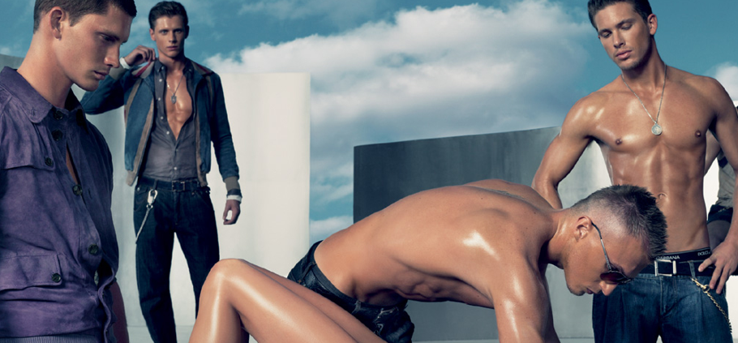

Task
Without captions or anchorage for these images, how do you interpret them?

Slide 12
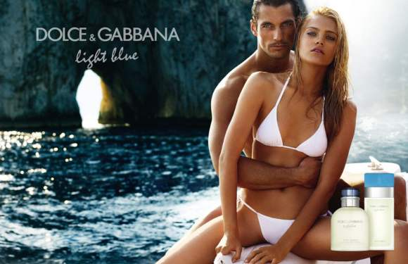

Slide 13
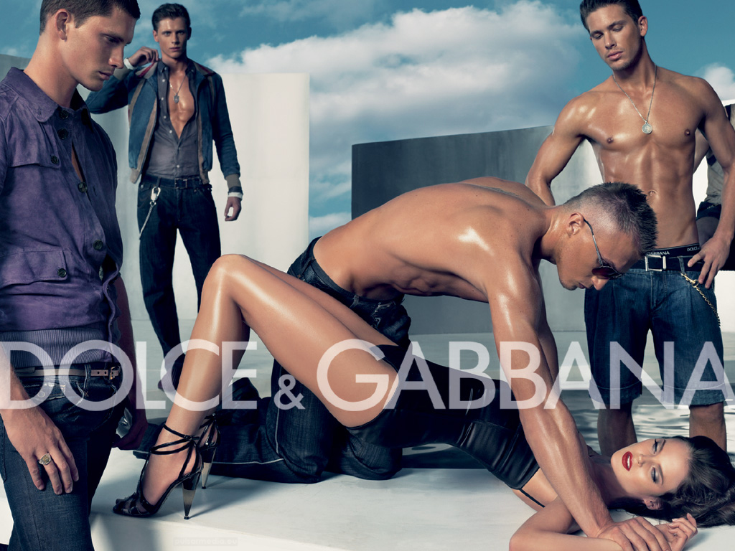

Slide 14
Language
COPY THIS DOWN
Polysemy and Anchorage
Without the anchorage these images could be interpreted in many ways. They are polysemic.
The text (signs) are required to anchor the meaning so the audience take the preferred reading of the text (the one the institutions wanted them to make).

Slide 15
Language
Conventions: established ways of treating genre, codes, narrative or representations.
e.g. interviews, voice-overs, talking heads, vox pops (voice of the public) are conventions of documentary and news; low-key lighting and sinister music are conventions of horror films such as Halloween
Ideology: This is a complex concept - in its basic form it is a set of ideas or beliefs which are held to be acceptable by the creators of a media text.
e.g. a text might be described as having a feminist ideology, meaning it promotes the idea that women are the equal of men and should not be discriminated against on the grounds of gender: Thelma and Louise or a text may have patriotic ideology towards ones country: Pearl Harbour
Myth: a story which a culture tells about itself which appears to be ‘common-sense’.
e.g., the romantic representation of Scotland (castles, lochs, thistles etc.) in Local Hero

Slide 16
Categories and Language
Group Task
Take notes and organise your findings on the images and sounds you see in the example opening credits that follow – be prepared to feedback your findings to the rest of the class.
Watchmen
Group One – Categories
Purpose - What is/are the purpose(s) of the opening credits? What evidence is there to support your analysis? What effect do they have on the viewer? How do they help to set up the story?

Slide 17
Categories and Language
Group Task
Take notes and organise your findings on the images and sounds you see in the example opening credits that follow – be prepared to feedback your findings to the rest of the class.
Group Two – Categories
Genre - What kind of film are we watching? What sub-genres are present? How can we tell (evidence)? How do the characters and setting fit in with the genre(s)?

Slide 18
Categories and Language
Group Task
Take notes and organise your findings on the images and sounds you see in the example opening credits that follow – be prepared to feedback your findings to the rest of the class.
Group Three - Categories
Tone - What feeling do you get from the opening credits? Do we get the impression that it is serious or comic? How can we tell (evidence)? List any other identifiable tones.

Slide 19
Categories and Language
Group Task
Take notes and organise your findings on the images and sounds you see in the example opening credits that follow – be prepared to feedback your findings to the rest of the class.
Group Four - Categories
Style – What is/are the main style(s) present? How does it all look and sound (think about the use of colours, lighting and sounds used)? Does it seem fast or slow-paced (editing)? How can we tell (evidence)?

Slide 20
Categories and Language
Group Task
Take notes and organise your findings on the images and sounds you see in the example opening credits that follow – be prepared to feedback your findings to the rest of the class.
Group Five - Language
Cultural codes - Which colours seem prominent in the opening credits? Why is this relevant? What do they stand for (denotations and connotations)? Comment on the sounds you hear as you go along. What do they represent (diegetic and non-diegetic)? Are there any symbols? Which characters are we introduced to and how are they represented?

Slide 21
Categories and Language
Group Task
Take notes and organise your findings on the images and sounds you see in the example opening credits that follow – be prepared to feedback your findings to the rest of the class.
Group Six- Language
Technical codes - Look out for times when the camera is at a low angle and when it is at a high angle. Why is this relevant? Does it help reveal anything about the characters? Look out for fade-ins, quick cuts, panning shots, zooms etc. Why are these relevant and what are the producers hoping to achieve by using them?

Slide 22
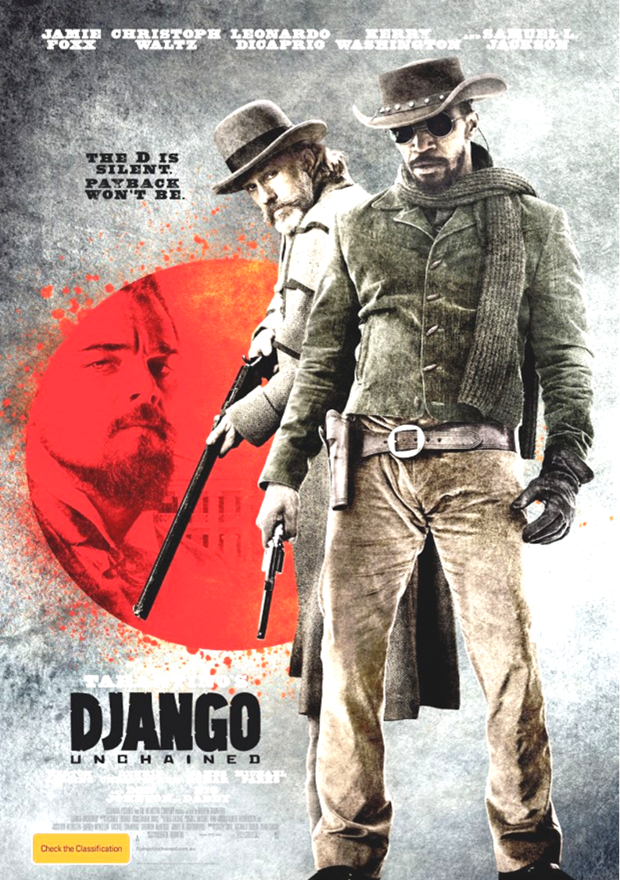

Slide 24
Categories and Language
Poster Analysis
Now that you have analysed some film texts, let’s look at a print one.
You will work in groups to analyse this too.

Slide 25

Motivation
To set the story in time, these are weapons associated with the wild west, to introduce elements of the story to aid audience understanding prior to viewing
Signs
The guns (shotgun, revolver);
The character stance (cultural code)
Denotation/Connotations of sign
The weapons attract a male orientated audience and connote the level of danger, death and violence that will be contained within the film
the two main characters who are at the forefront of the poster stand back to back which connotes that they are working together and looking out for one another
Jamie Foxx’s character is standing in-front which makes it clear that he is the main character.

Slide 26
Motivation
To set the story in time as cowboy hats were worn during a very specific time period e.g. late 1700-late 1800s
Signs
The costume of Jamie Foxx (cultural code) with the cowboy hat (convention of Westerns), riding apparel, black glove and sunglasses, etc.
Denotation/Connotations of sign
The costumes connote men of action, always ready for violence (ready stance of character, un-gloved right trigger hand, the scarf that is tossed over the shoulder)
The cowboy hat also connotes freedom - slaves at the time were prohibited from wearing headwear like this, thus indicating that his character is a free man during a time of slavery
The black glove and the dark sunglasses connote mystery and a person to be feared

Slide 27
Motivation
To set the story in time and introduce the main character, Django.
Signs
The title text and font colour (technical codes)
Denotation/Connotations of sign
Like the use of costume, slavery and freedom is further supported by the text (anchorage) in the title Unchained;
Black connotes strength and authority which is further supported by the use of capitalisation and bold font;
The black also contrasts with the brightness of the red which connotes that these two characters (Foxx and DiCaprio) will clash in the film

Slide 28
Motivation
To introduce his character as the villain of the film and target (red circle)
Signs
The red spatter, use of the colour red to cover Leonardo Di Caprio’s character, costume (shirt and cravat)
Denotation/Connotations of sign
The red spatters connotes danger, blood, violence and death; the circle surrounding him connotes that he is the target of the other two;
There are connotations of money, power and sophistication which stem from the costume of DiCaprio’s character, he is notably dressed in much smarter attire than the other two who appear more ready for action;

Slide 29
Signs
The text (anchorage) contained in the tagline (technical and referential code)
Motivation
Introduces the violent nature of the film and the theme of vengeance (word choice of payback)
Denotation/Connotations of sign
The phrasing of the tagline has connotations of quietness and stealth, possibly indicating that Django is a quiet individual, but it also connotes violence through the revenge word of “payback”;
this vengeance (possibly against Di Caprio) reveals that it will not be silent but violent – the colour of the font supports this as black connotes power and fear.

Slide 30
Ideology and Myth
The poster explores the ideology and myth of the use of violence as a means of revenge/vengeance.
This may have both positive and negative influences on the potential audience; a female audience may be put off by a film that promotes violence as the only means necessary.
A male audience could engage with the idea that brutal violence and action is the only way to sort out disputes as opposed to using words.

Slide 31
Categories and Language
Brief
As a group, create a presentation (either on paper as a poster, or a Prezi or PowerPoint) to analyse a poster you have chosen as a group.

Slide 32
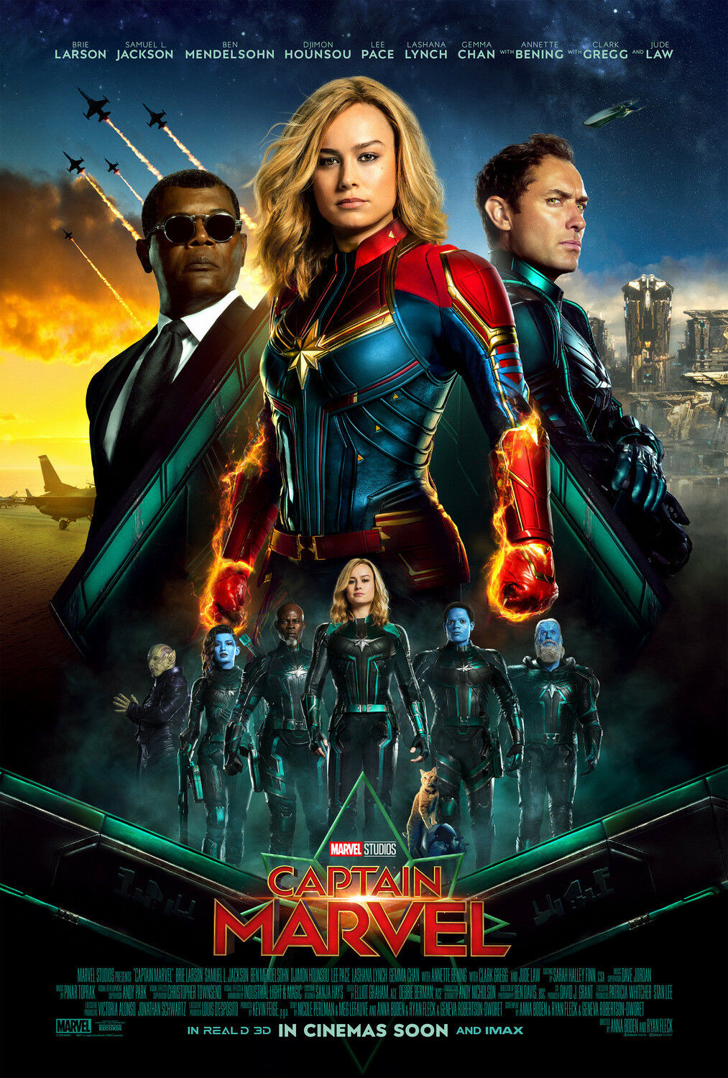
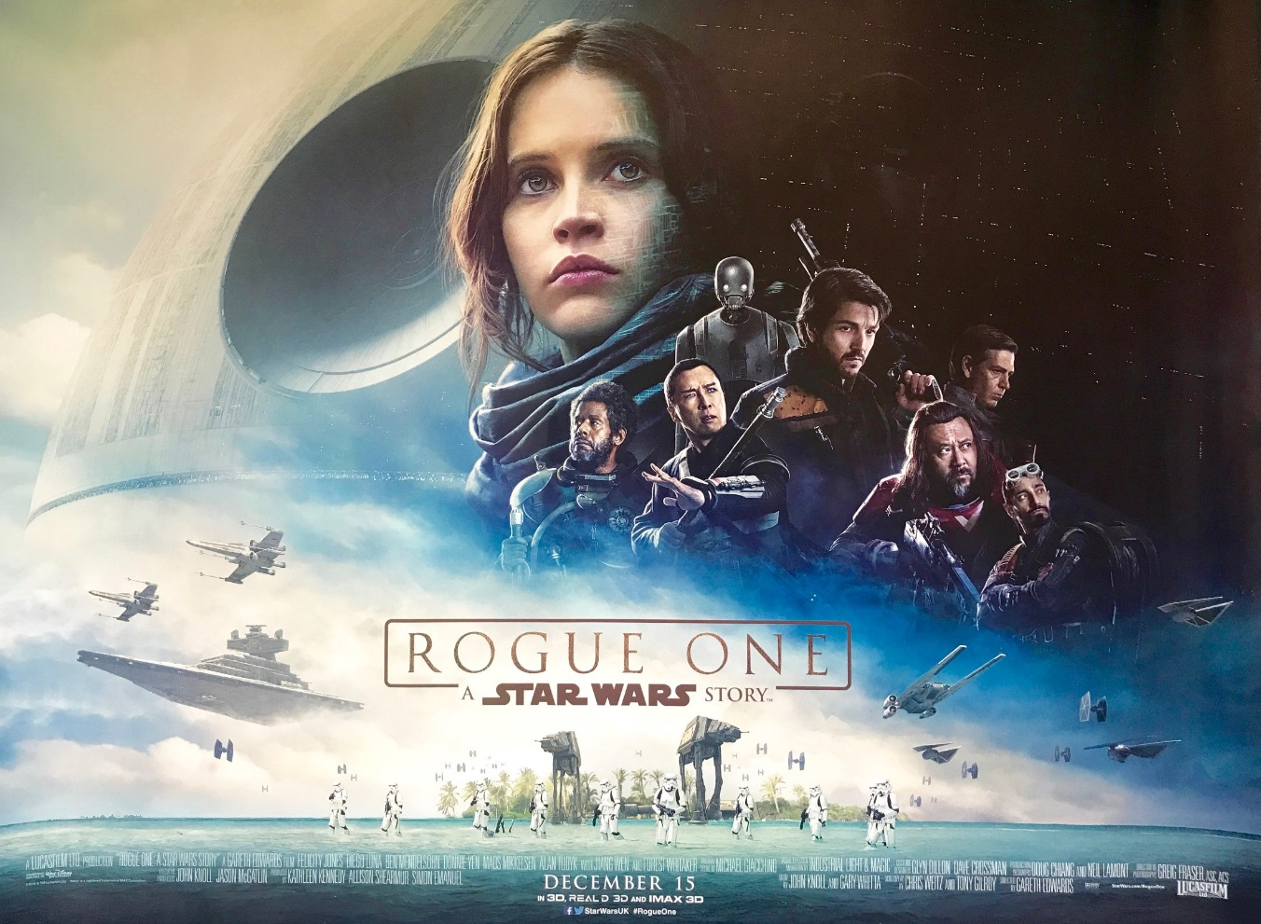
Things to include:
Signs
Motivation of these signs – why have they been included?
Denotation/connotation of signs
Ideology and myth

Slide 33


