Slide 1
National 5 Media
Ms Nitsche

Slide 2
The media is one of the most powerful, influential tools that we have today. It influences everything we do, such as: our opinions, attitudes, tastes and what we find entertaining. The aim of this course is to introduce the student to key ideas and strategies used in today’s media and how they affect us as individuals and a society.

Slide 3
The four main areas that are covered in this course are:
Film
Ever wondered how a film can make you cry or feel excited? The aim of this unit is to broaden basic film knowledge and analyse the many sophisticated techniques that film-makers use to create the magic of cinema.
Television
Ever wondered why people are addicted to soaps or how the news can shape your opinion? In this unit you can find out this and more. The aim of this unit is to analyse narrative techniques used in modern television and how they affect the viewer.
Advertising
Ever wondered why whenever a coke advert is on you’ve got to have one straightaway? The aim of this unit is to explore the many sophisticated techniques that advertisers use to manipulate the public into buying their product.
Film Production
Ever wanted to be involved in film production? Then this is the course for you! In the practical element of the course you will be involved in the creative process of producing a short piece of film. This will require you to work as part of a team and be responsible for a key part of production.

Slide 4
Analysis: Areas of Study
We will study a variety of texts, including TV, film, print, advertising, etc.
These are just some the areas that we will study:
Representation – use of public image
Audience – psychological analysis of intended audience
Narrative – structure of stories and how the brain interprets information
Institution – legal and business controls
Society – societal attitudes towards ideas/topics
Language – how techniques and images are used to create meaning
Categories – genre markers
How advertising companies use psychological tricks to force the public into buying their products.
How news stories are constructed
How news companies can force the public into changing their opinion on important subjects.

Slide 5
Course structure
This Course is divided up into two areas: analysis and production. This Course provides the opportunity to integrate these skills because analysis and creation are inextricably linked. Each component also offers opportunities for learners to focus on particular skills.
Analysing Media Content (National 5)
The purpose of this component is to develop the skills to analyse media content. This Course provides learners with the opportunity to develop knowledge and understanding of media contexts, roles and the key aspects of media literacy central to the detailed analysis of media content.
Creating Media Content (National 5)
The purpose of this component is to develop the skills to plan and create media content, and evaluate production processes. This Course provides learners with the opportunity to develop knowledge and understanding of the key aspects of media literacy central to creating media content.

Slide 6
Structure and Coverage of the Course Assessment
The Course assessment will consist of two Components: a question paper and an assignment. The question paper will have one Section. The assignment will have two Sections.

Slide 7
Component 1 — Question Paper
The purpose of this question paper is to assess the learner’s ability to apply knowledge and understanding by analysing media content in context. This question paper will give learners an opportunity to demonstrate the following skills, knowledge and understanding:
Analysis of familiar media content in context.
Analysis of the role of media within society.
Analysis of unseen content.
Applying knowledge and understanding of the key aspects of media literacy.
This question paper will have 60 marks (50% of the total mark).
This question paper has one Section.

Slide 8
Component 2 — Assignment
The purpose of the assignment is to assess the learner’s ability to apply the skills, knowledge and understanding acquired throughout the Course in a production of media content. Learners will carry out an assignment set by SQA, using a brief negotiated in centre.
This assignment will give learners an opportunity to demonstrate their skills, knowledge and understanding of production techniques in an assignment which:
Requires consideration of possibilities and problem solving in planning and production processes.
Requires application of knowledge and understanding of the relevant key aspects of media literacy.
Requires the learner to evaluate the impact of actual or likely constraints on media content.
The assignment will have 60 marks (50% of the total mark). This assignment has two Sections.

Slide 9
Assignment Sections
Section 1: Planning (25 marks)
In response to a negotiated brief, learners will research and plan media content, and consider the impact of actual or likely constraints.
Section 2: Development (25 marks)
Learners will make the planned media content and explain their use of media codes to create impact or convey connotations. Marks will be awarded for the learner’s ability to research and generate ideas appropriate to the brief, develop and justify media content choices and evaluate the impact of actual or likely constraints on the media content.
Both elements are externally assessed.

Slide 10
Let’s get started
https://www.youtube.com/watch?v=Orq_75kFi8I
In your groups, discuss this music video. Think about the media techniques being used, and the meaning they convey. Compile as many notes as possible on the sheet of A3 paper on your desk.

Slide 11
Go to your 9 o’clock partner
Discuss the music video, and its use of:
Narrative – what story is being told here?
Representation – how are certain groups presented here? How is the central character portrayed?
Audience – who would find this video appealing? Think about what story it is exploring, the message being portrayed, as well as institutional aspects, i.e. actors, etc.
Language – what cultural codes are used? What film techniques are used? Lighting, mise-en-scene, camera shots, etc.

Slide 12
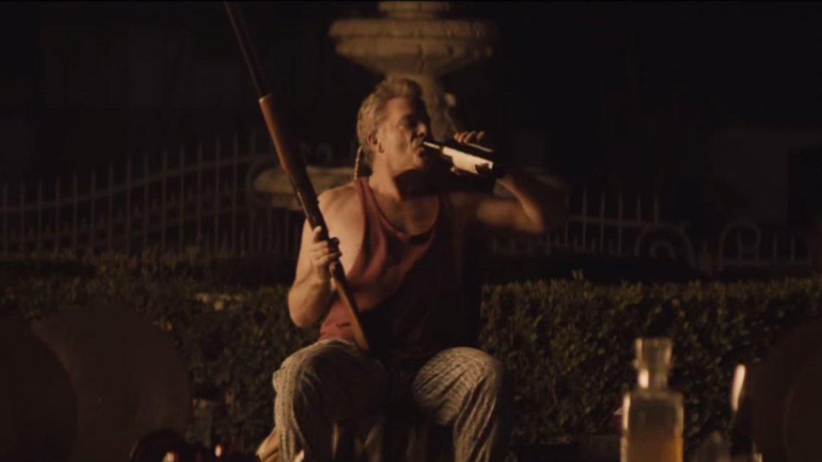
Starter
Individually, analyse this shot from the music video.

Slide 13
Go to your 12 o’clock partner
Discuss the music video, and its use of:
Narrative – what story is being told here?
Representation – how are certain groups presented here? How is the central character portrayed?
Audience – who would find this video appealing? Think about what story it is exploring, the message being portrayed, as well as institutional aspects, i.e. actors, etc.
Language – what cultural codes are used? What film techniques are used? Lighting, mise-en-scene, camera shots, etc.

Slide 14
Go to your 6 o’clock partner
Discuss the music video, and its use of:
Narrative – what story is being told here?
Representation – how are certain groups presented here? How is the central character portrayed?
Audience – who would find this video appealing? Think about what story it is exploring, the message being portrayed, as well as institutional aspects, i.e. actors, etc.
Language – what cultural codes are used? What film techniques are used? Lighting, mise-en-scene, camera shots, etc.

Slide 15
Class Discussion
Horse – representing escape from his anxieties, thoughts?
Slow paced moments of the music reflect his sadness; increased tempo reflected in his angry outbursts.
Character couldn’t relax – lots of shots of him doing things, like on the roof, walking around, seems restless, doesn’t seem to know where he is.
Character is alone for the majority of the video – seems lonely, lost, isolated
Women represent a form of escape – meant o bring him some form of pleasure, but doesn’t seem to last
Women as objects – seemingly faceless, no clear identities; using them for company; trying to recapture lost youth, success, virility; reclaiming lost sense of identity and strength
Dwelling on his past – looking at old records, photos; present seems wealthy but empty, past has a stronger hold.
Achieved everything he can. But with others – now he is alone, and his wealth clearly means nothing.

Slide 16
Task
In your groups, you are going to design a poster analysing the ‘Bloodstream’ music video.
In it, you should consider:
Narrative – what story is being told here?
Representation – how are certain groups presented here? How is the central character portrayed?
Audience – who would find this video appealing? Think about what story it is exploring, the message being portrayed, as well as institutional aspects, i.e. actors, etc.
Language – what cultural codes are used? What film techniques are used? Lighting, mise-en-scene, camera shots, etc.
The poster should be detailed, informative AND be very well-presented.

Slide 17
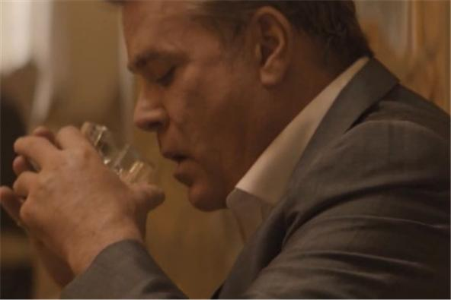
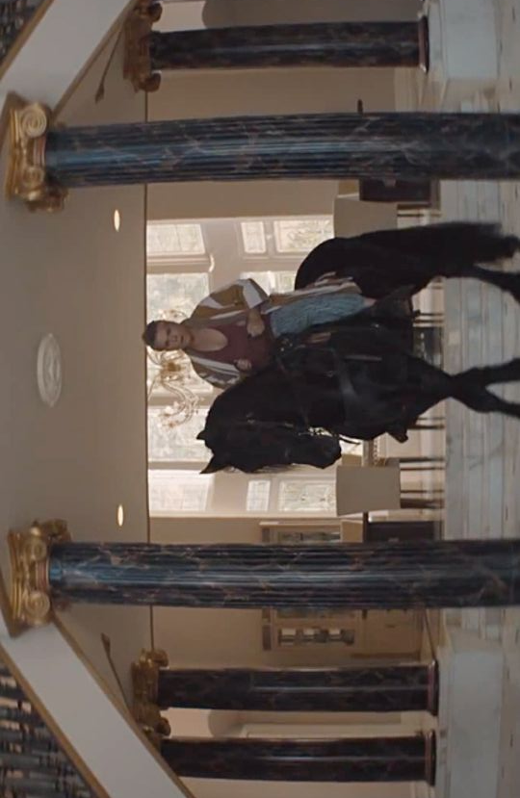
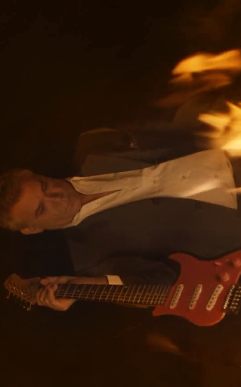
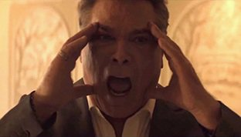
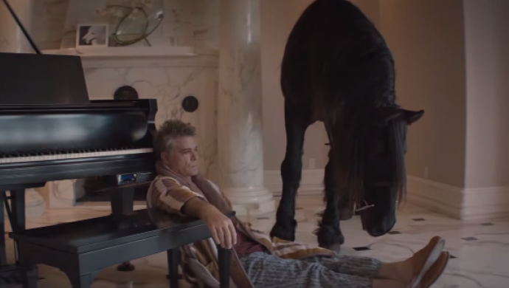
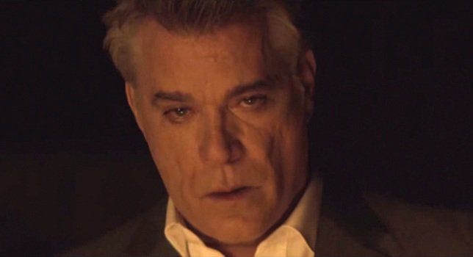

Slide 18
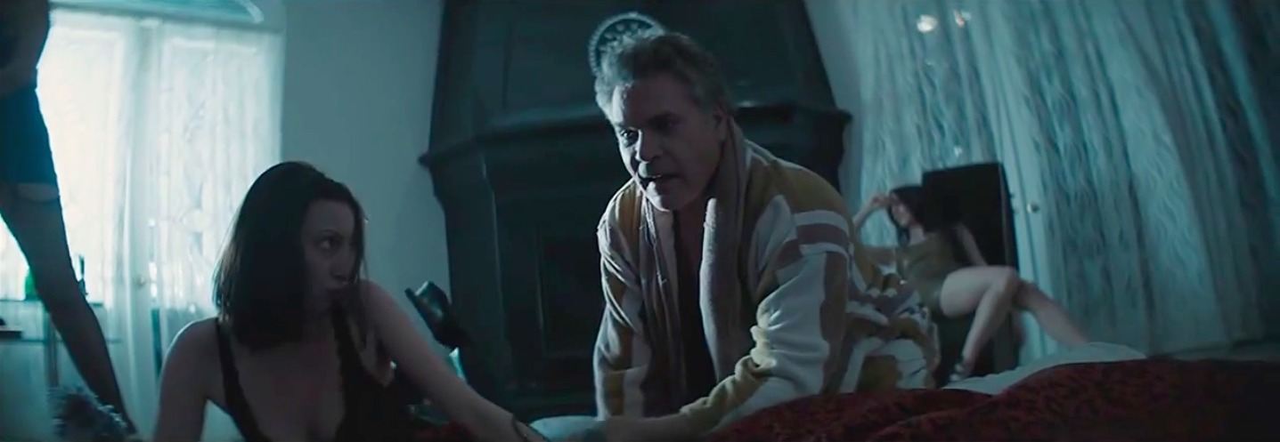
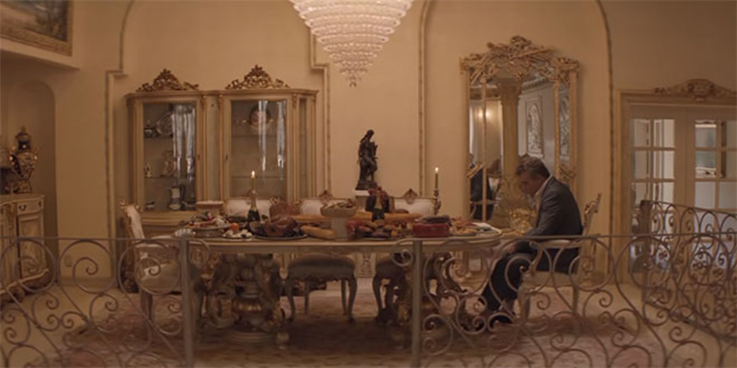
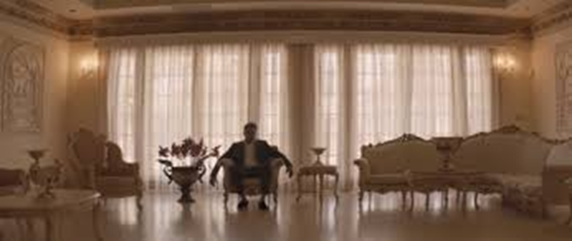
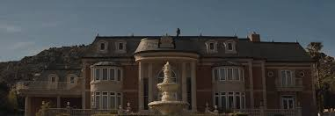
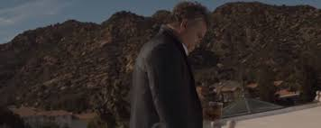
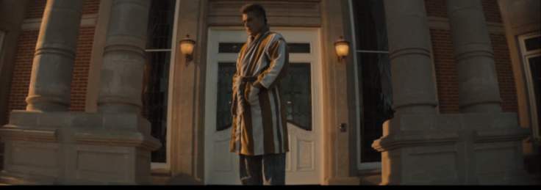

Slide 19
