Slide 1
Narrative Codes, Conventions and Structures
An Introduction

Slide 2
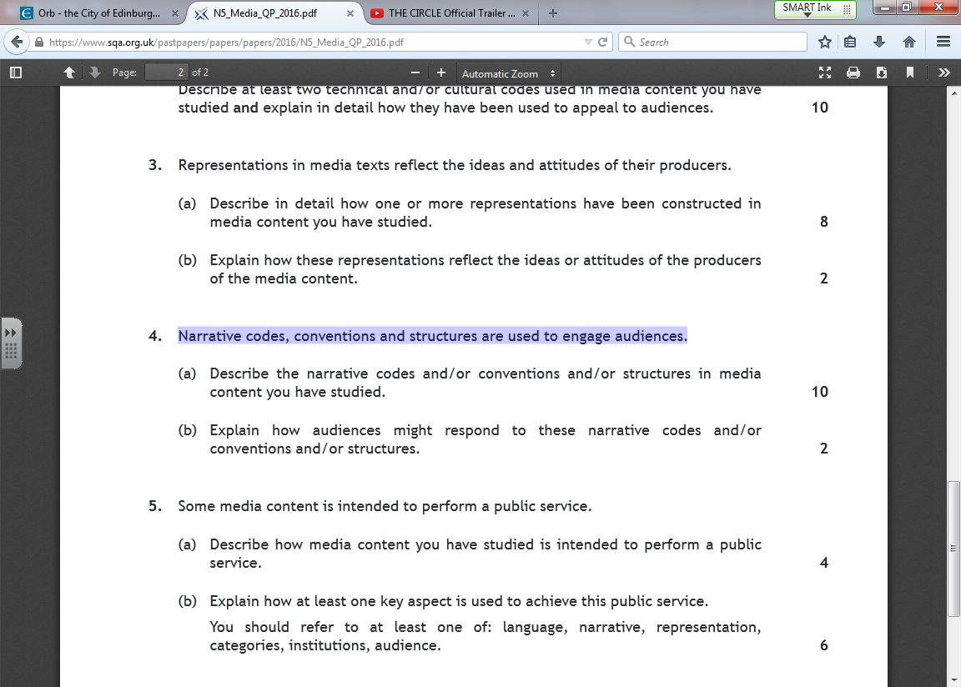

Slide 3
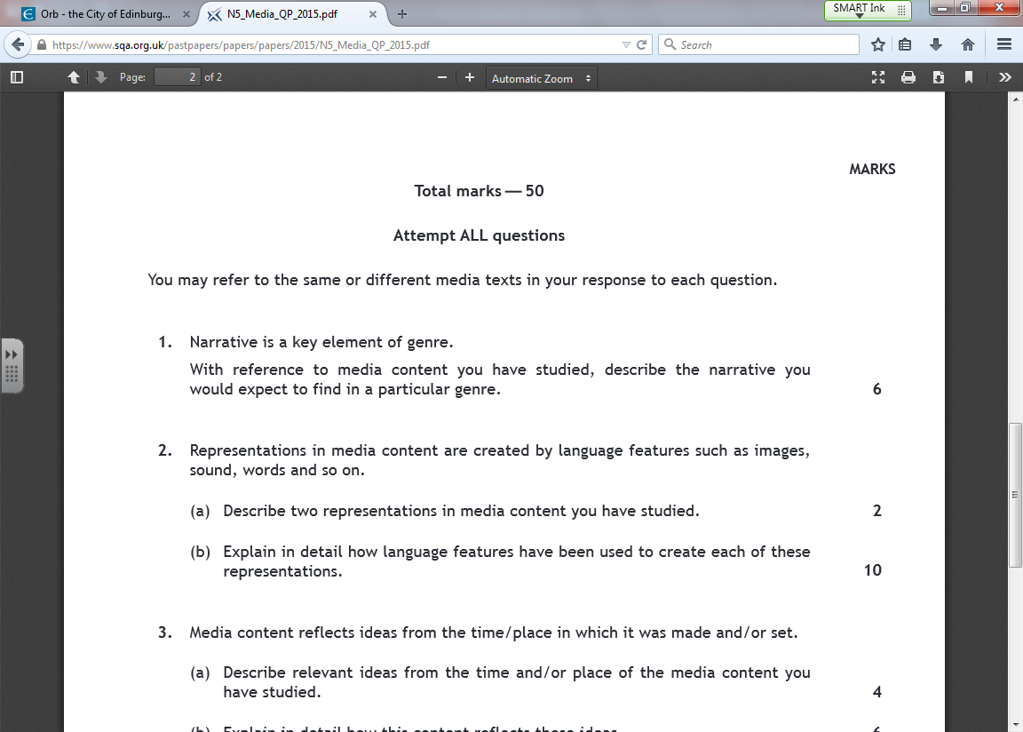

Slide 4
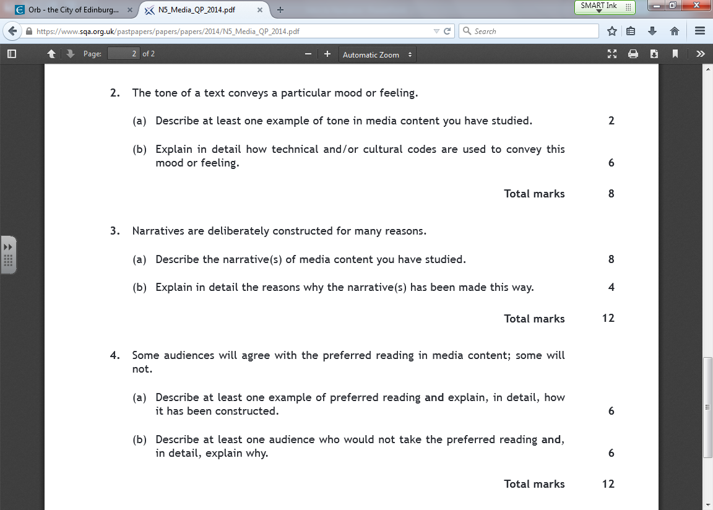

Slide 5
What is narrative?
The order of information – how you order the events of the story.
WHY IS NARRATIVE IMPORTANT?
  Creates tension
  Keeps the audience interested
  Increases emotional engagement of audience

Slide 6
Narrative Checklist
Narrative Structure and Theories
Todorov
Hero’s Journey
Philosophy of Horror
Linear or non-linear
Narrative Conventions
Character functions (archetypes)
Narrative Codes
Binary Oppositions
Enigma codes
Action Codes

Slide 7
Narrative Structure - Todorov
Equilibrium – the first part of the story, where everyone is happy and/or content.
Disruption – this is where a problem occurs, or something happens to disrupt the happiness of the equilibrium.
Recognition of disruption – this is where everyone realises there is a problem and reacts; this section is often quite chaotic.
Attempts to repair disruption – where characters attempt to repair the damage and restore the problem.
New equilibrium – when the problem is resolved and normality can resume again.
Task
Can you briefly describe each stage in Shawshank?
Can you identify a language code from each stage to back up your point?

Slide 8
Shawshank
You will need to be able to pinpoint each stage of the narrative in relation to ‘Shawshank’.
This needs to be clear, easy to remember and accurate for the purpose of the exam.
You must also include codes and analysis to prove you are correct!

Slide 9
Equilibrium
The first part of the story, where everyone is happy and/or content.
Never seen, just implied.
Andy is a wealthy banker who loves his wife and enjoys his freedom.
Evidence
Suit and tie in court – suggest Andy is smart, wealthy and successful
Inkspots “If I Didn’t Love” playing on the car radio – a love song, emphasises how much he loves his wife (in spite of her betrayal)
Referred to as a “hotshot banker” at several points throughout the film – by Hadley, by Elmo (his wife’s actual killer)
After Tommy’s death, and just prior to his escape, Andy tells Red how much he loved his wife (“God, I loved her”) and describes how he proposed to her

Slide 10
Disruption
This is where a problem occurs, or something happens to disrupt the happiness of the equilibrium.
This could be one of two moments in the film:
Andy’s wife being murdered
Andy being sent to Shawshank
Evidence
Andy is accused of her murder – we see him on the stand in a court room, being accused of her murder
Dialogue – judge says that Andy is “cold” and shows “no remorse” for what he has allegedly done
Close up of Andy’s face – conveys his sense of shock
Andy arriving at Shawshank – other prisoners watching him arrive, pressed up against the barbed wire; Andy’s costume – a smart suit and tie – contrasts sharply with the shackles he is bound with, as well as the appearance of the other prisoners
Montage of Andy ‘settling in’ to Shawshank – no longer works in a bank, works in a laundry; constantly threatened and attacked by Boggs and ‘The Sisters’, all sharp contrasts to the life we are told he had before as a successful banker.

Slide 11
Recognition of disruption
This is where everyone realises there is a problem and reacts; this section is often quite chaotic.
Andy getting used to life at Shawshank
Evidence
Montage of Andy ‘settling in’ to Shawshank – no longer works in a bank, works in a laundry; constantly threatened and attacked by Boggs and ‘The Sisters’, all sharp contrasts to the life we are told he had before as a successful banker. Becoming accustomed to the brutality of Shawshank.
Andy started to get to know Red and the others – he asks him for a rock hammer; they play chess and kings together, etc. All of this is interspersed with regular violence, particularly the brutal sexual harassment he suffers at the hands of Boggs.
ANALYSE WITH REFERENCE TO LANGUAGE/CULTURAL CODES

Slide 12
Attempts to repair disruption
Where characters attempt to repair the damage and restore the problem.
Andy deciding to escape from Shawshank after Tommy’s murder
Andy trying to find a sense of normality within Shawshank – building the library, helping other prisoners gain qualifications, sorting out tax returns for the guards and warden, etc.
Evidence
The flashback and Red’s voiceover showing how Andy escaped – idea that Andy has been planning this for nearly twenty years.
Medium shot of Andy crawling through the sewage pipe in an attempt to escape, see the sludge everywhere, Andy vomits – shows the lengths he is prepared to go to in order to break free; when he eventually gets out of (very lengthy) pipe, he strips himself of his prion clothing, symbolically washed clean by the rain.
Consequences for the others – Warden the killing himself; the gunshot in his office, window smashing then silence as he finally faces justice.

Slide 13
New equilibrium
When the problem is resolved and normality can resume again.
Evidence

Slide 14
Pinpoint Todorov
1. https://www.youtube.com/watch?v=svnAD0TApb8
2. https://www.youtube.com/watch?v=4sj1MT05lAA
3. https://www.youtube.com/watch?v=s9APLXM9Ei8

Slide 15
Narrative Structure – Hero’s Journey (Campbell’s Monomyth)
Linear narrative
There are 12 stages to this narrative.
Half of the narrative takes place in the “ordinary world” and half takes place in a “special world”.
Key Points
The hero is normally reluctant to accept a challenge.
He/she meets a mentor who normally convinces them to take up the challenge.
The hero will come across challenges/enemies/allies.
As the hero approaches the innermost cave they will face an ordeal.
The hero will “die” but be resurrected in some way.
They will return to the “ordinary world” and be changed in some way.

Slide 16
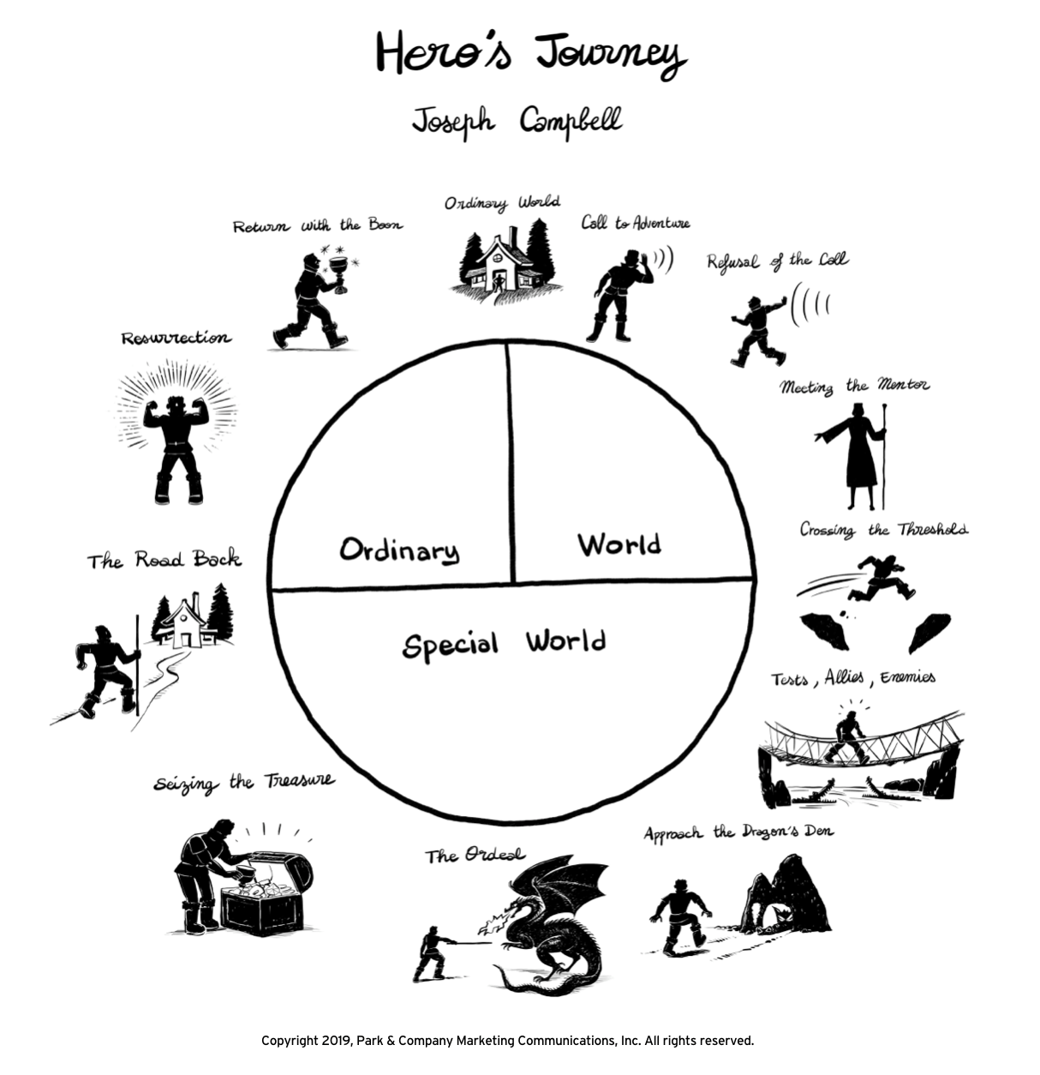

Slide 17
The Hero’s Journey
https://www.youtube.com/watch?v=6eNun-x_s2Y&t=22s

Slide 18
Task
What is Andy’s quest? What is his aim?
What message does the film have to us about hope and freewill?
Describe and analyse evidence from the film which shows each of these stages. You should make clear reference to language throughout your answer.
E.g.
Refusal Of The Call | We see one inmate break down and lose his composure – and life - the first night at Shawshank. Not Andy. For him, "refusal of the call" isn't a refusal to accept that he's really in prison, but rather a refusal to accept that's the way it's going to be for the rest of his life. | When Red first meets Andy, his voiceover emphasises Andy’s refusal to let Shawshank defeat his sense of hope: “[narrating, referring to Andy] I could see why some of the boys took him for snobby. He had a quiet way about him, a walk and a talk that just wasn't normal around here. He strolled, like a man in a park without a care or a worry in the world, like he had on an invisible coat that would shield him from this place.”

Slide 19
Narrative Structure – The Philosophy of Horror
https://www.slideshare.net/belair1981/horror-narratives

Slide 20
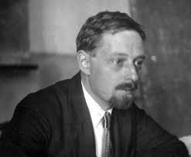
Narrative Conventions - Character Functions
Vladimir Propp suggested that:
Characters in stories perform narrative functions (roles), some more than one at a time
There are 7 narrative functions
Villain, Hero, Princess, Dispatcher, Donor, Helper, False-hero
Each character’s actions result in consequences and this is what makes for an interesting story

Slide 21
Narrative codes - Character Roles
Hero
Villain
Heroine
Dispatcher
Mentor
Donor
Helper
Princess
What do you think each role does in a story?

Slide 22
Character | Character’s function | Example in Film/Literature/TV
Hero | The seeker/victim/underdog in the narrative - in opposition to the villain
Princess | The princess takes two forms: 1. The object sought by the hero 2. The reward
Villain | Struggles against the hero, creating conflict
Dispatcher | Sends the hero on the quest
Donor | Prepares the hero or gives them something special to assist them – eg. wisdom or a magical weapon
Helper | The sidekick(s) who help the hero to fulfill their quest and save the princess
False hero | A variation of the villain – appearing to act heroically but ultimately opposing the hero

Slide 23
Character Roles - Star Wars
Hero Luke
Villain Darth Vadar
Heroine
Dispatcher
Mentor
Donor
Helpers
Reward

Slide 24
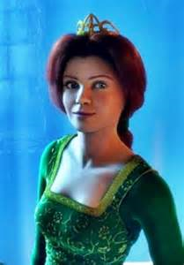
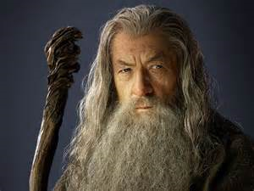
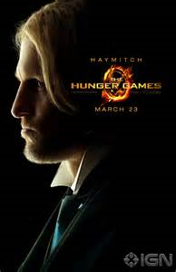
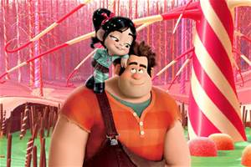
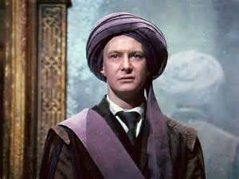
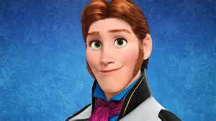
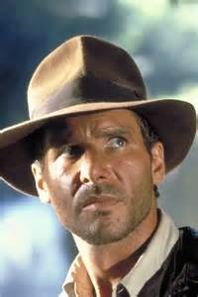

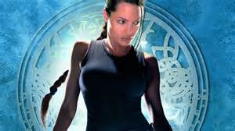
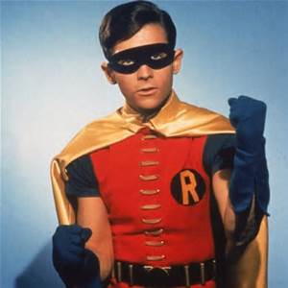
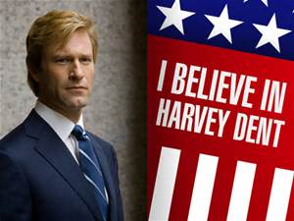


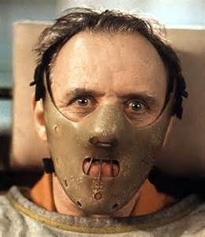
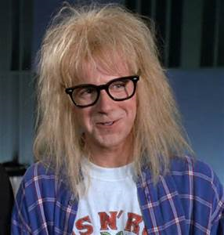
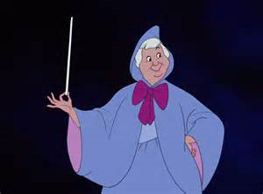
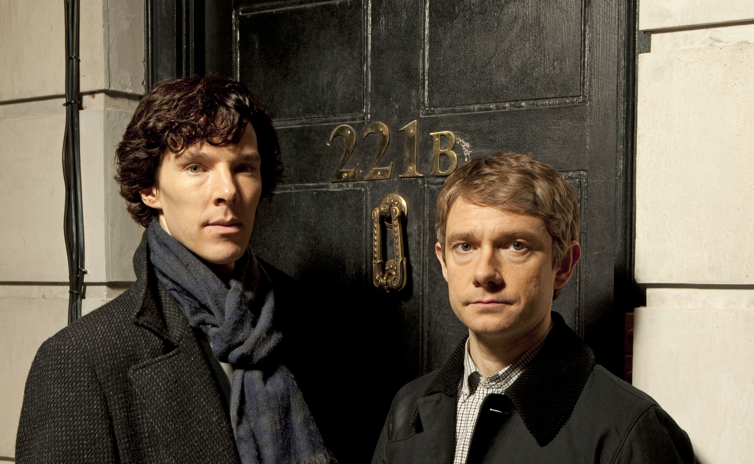
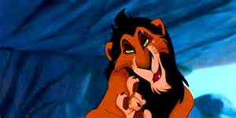
What character functions do they perform?

Slide 25
Character Roles
The Shawshank Redemption
Hero Andy
Princess
Villain
Dispatcher
Donor
Helper Red
False hero

Slide 26
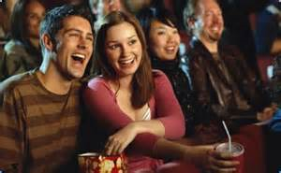
And why do audiences appreciate the use of conventional character functions?
It goes back to:
Pattern and predictability
Exciting “reinventions”
Comfort in familiarity
Wanting ‘more of the same’
The conflict created between characters fulfilling their roles is the stuff we enjoy!!

Slide 27
Character functions in Sleepy Hollow
Describe
In ‘Sleepy Hollow’ Burton has incorporated Propp’s character functions.
Ichabod Crane is the “hero”. His role is to defeat the “villain” who is the Headless Horseman.
However Crane is not a typical hero. He is scared of blood and gore (faints at the sight of it) and is a coward (hides behind women and children). Normally the hero is brave and courageous.
Explain
This re-invention of the “hero” is exciting for the audience as they haven’t come across such a realistic and human “hero” before.

Slide 28
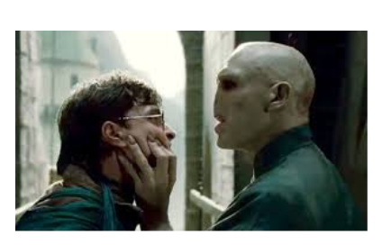
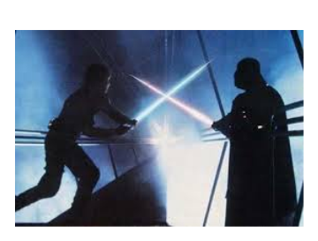
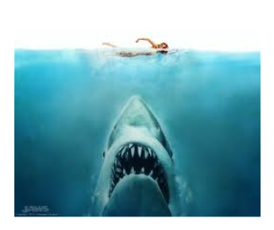
Binary Oppositions
Theorist Levi-Strauss said that narratives (stories) are made up of opposing forces called binary opposites (eg. good and evil) in order to create conflict.
He said it is conflict that drives narratives forward -- that all narratives are built around the attempt to resolve the conflict resulting from these binary opposites.
For example:
Good/evil
Past/present
Poor/rich
Freedom/Slavery

Slide 29
Binary Oppositions
List as many binary oppositions as you can think of in Shawshank.

Slide 30
Why study binary oppositions in The Shawshank Redemption?
Binary opposition is easily understood by all audiences -- crucial if you want word of mouth to spread.
Clear and extreme opposites encourage audiences to take sides:
- we are positioned on the side of Andy
- we become invested in Andy and Red and root for their continued survival.
Darabont makes the 'baddies' and 'goodies' of the film fairly clear cut for us so that conflict is created. This in turn creates enigma codes:
- What enigmas are created through binary opposition in 'Shawshank'?:
- This conflict is what drives the action of the film forwards. Without conflict, the narrative would be thin and unsuccessful as a media product.

Slide 31
Andy = the protagonist/hero
Shawshank =
the antagonist/villain
But how do we know this?
Shawshank destroys hope.
Evidence:
Shawshank wants to keep inmates in the dark.
Evidence:
Shawshank is a violent place and frightens us.
Evidence:
Shawshank dehumanises its inmates and makes us angry.
Evidence:
Andy has hope.
Evidence:
Andy is educated and wants to learn.
Evidence:
Andy isn't a violent man.
Evidence:
Andy has human reactions and we can relate to him.
Evidence:

Slide 32
Action Codes
Action codes are events or actions in the story that drive the story onwards. They are major or significant moments in the story.
Gladiator:
The Emperor’s death
Maximus fights in the Colosseum
Lord of the Rings:
Gandalf visits Frodo
Frodo sets out on the adventure

Slide 33
Action Codes
Write down three major action codes from The Shawshank Redemption.
Identify the action code that disrupted the normality.
Identify the action code that brings about the new normality.

Slide 34
Shawshank Action Codes
Action Codes
Judge sentences Andy to life imprisonment
Andy arriving at prison
Andy offers to help the guard with his taxes
Brooks committing suicide
When Tommy arrives – reveals Andy’s innocence
When the warden has Tommy shot
Red being rejected for parole
Andy escapes
Red rejoins Andy on the beach

Slide 35
ENIGMA CODES
Enigma codes are questions, puzzles or riddles about the plot that the keeps the audience watching the film.
Stories contain:
  - Major enigmas (that often last the whole film)
  - Minor enigmas (that may last for a scene)

Slide 36
Engima Codes
Write down the enigma codes for The Shawshank Redemption
Decide which ones are the major enigmas and which ones are minor enigmas.

