Slide 1
Representation
The Shawshank Redemption

Slide 2
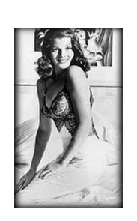
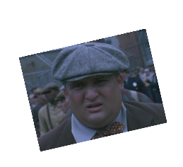
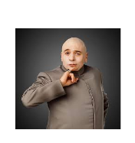
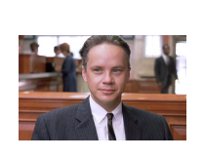
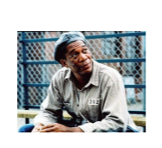
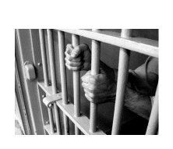
What representations do we see in The Shawshank Redemption?
Gender – men and women
Evil
Race – relationships between black and white people (linked with another key aspect, Society)
Prison

Slide 3
Stereotypes – of people, places
Non-stereotypes – go against “the grain”

Slide 4
Representations can impact particularly on which of the other key aspects?
Narrative
Language
Categories
Institutions
Audience

Slide 5
When we consider representation we must ask certain questions:
Who and what is selected and how are they portrayed - positively or negatively? Accurately?
Who and what is not selected (de-selection)?
How is the representation created? (Look at other KAs e.g. Language [mise-en-scene, framing etc.], Categories [genre], Narrative [narrative codes/conventions] etc.)
Who has created the representation (Institution)? What is their intention? (Preferred reading)
What is the effect of the representation? (Consider different audiences and how they might respond to it – differential decoding)

Slide 6
When we consider representation we must ask certain questions:
Who and what is selected and how are they portrayed - positively or negatively? Accurately?
Who and what is not selected (de-selection)?
How is the representation created? (Look at other KAs e.g. Language [mise-en-scene, framing etc.], Categories [genre], Narrative [narrative codes/conventions] etc.)
Who has created the representation (Institution)? What is their intention? (Preferred reading)
What is the effect of the representation? (Consider different audiences and how they might respond to it – differential decoding)

Slide 7
Questions
Having watched the film can you spot a glaring omission related to gender representations?
Why does this almost "have" to be the case for much of the film?
How do the filmmakers get around this?

Slide 8
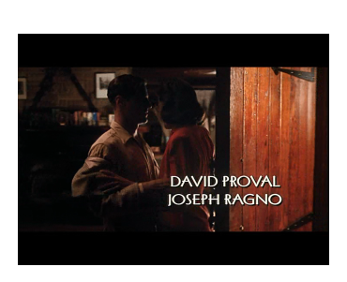
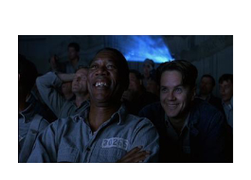
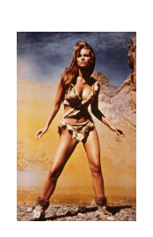
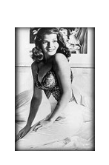
Gender representations
There are two examples of women being represented in the film. Can you identify these?
Women are represented as objects of desire.
They are also represented as treacherous and unfaithful.

Slide 9
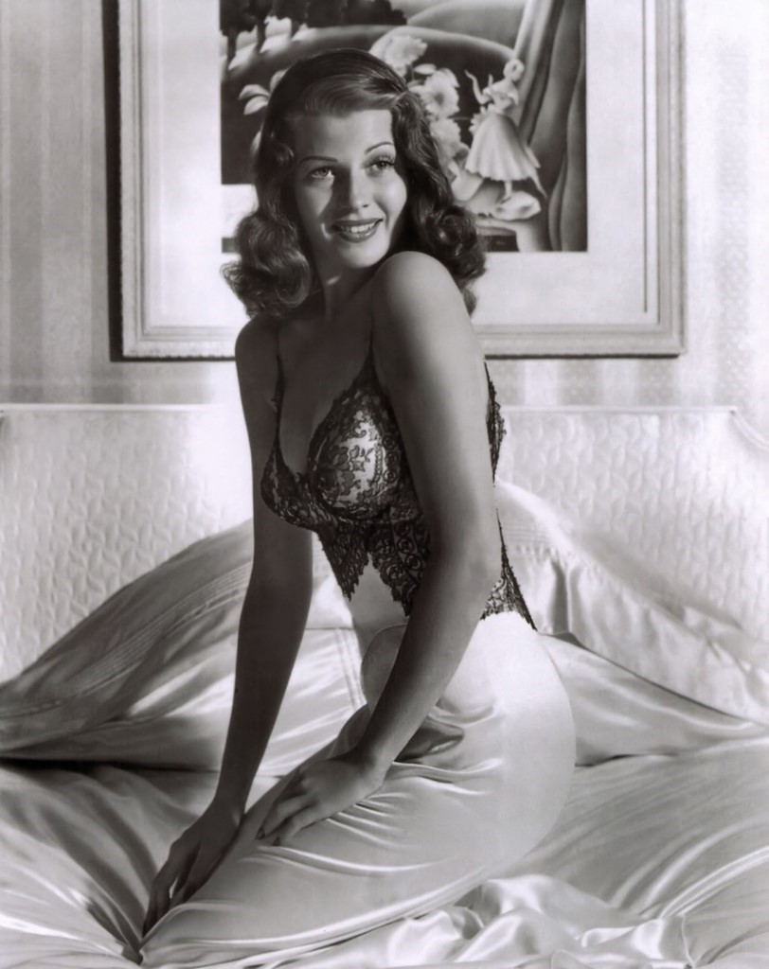
Describe and analyse how women are represented in the film.
To answer this question you will need to analyse the two representations.
Work in pairs. Remember describe one code at a time and provide detailed analysis.

Slide 10
Women are represented as objects of desire
(The following refers to the poster of Rita Hayworth in Andy's cell and to the characters watching ‘Gilda’)
Facial expression
Hayworth's smiling and this connotes she is comfortable and happy with where she is and what's happening.
Her expression is warm and inviting - encouraging the onlooker to keep looking.
Costume
Hayworth is fairly exposed, her chest and arms are bare. The slip is lacy and black.
Black connotes she has a dark sexual side, white suggests she is also pure and innocent. The slip is figure hugging leaving little to the imagination.
Setting
Hayworth’s kneeling on a bed. The sheets are mussed up connoting that she has already indulged in some "bedroom activity".
Again, this emphasises her sexuality and appeal to the viewer.
Body language
Hayworth is turned towards the onlooker, inviting them (and indeed anyone looking at the poster!) to keep looking.
Dialogue
Reference to Gilda (played by Hayworth) "Here's the canary."
Canaries are eye catching birds (yellow) who make beautiful sounds - this suggests that Gilda (the character) is something to look at and admire and desire.
OR "I love that shit she does with her hair"
By not referring to the female actress by her name, Red's character is showing that her looks are more important than her personality. he is automatically objectifying her. By referring to her movements as "shit" he is devaluing her.

Slide 11
Women are represented as unfaithful and treacherous
2. (The following refers to Andy’s wife, seen in the opening scenes of the film, and spoken about later by Elmo Blatch, the man who killed her)
Costume
Andy's wife is wearing a red dress.
Red has traditional connotations of love, a warning sign, lust, blood, anger, passion. By placing her in this dress the director is suggesting that she is dangerous and passionate. She poses a danger to Andy and is warm blooded compared to his coldness.
Body language
The only time we see her she is about to have sex and is being undressed by someone other than her husband.
This suggests the character is wild and she is desperate to be with someone other than her husband because she can't even wait to get into bed. She is unfaithful and driven by desire.
Setting
The room is dark and shadowy.
This shows that she is secretive and wants her actions to remain hidden.
Dialogue
Elmo describes Andy’s wife, when he confesses to Tommy about killing her - "Him and his tasty bitch he was with."
The word 'tasty' reduces Andy's wife to an object to be admired; 'bitch' condemns her for cheating without placing any blame on the husband.

Slide 12
Ethnicity
Q. How is ethnicity represented?
Q. Is race portrayed as an issue in the prison?
Q. Why would the filmmakers decide not to portray race as an issue?

Slide 13
Ethnicity
Q. How is ethnicity represented?
Red (Morgan Freeman) - the lack of representation in the film (the only non-white central character is Red).
African Americans are shown to be inferior to white Americans.
Seen through the roles they play ("second fiddle" to the white man) – they are seen only as assistants or helpers (such as hospital porter at the beginning who reports on Fatass’ death; laundry helper who assists Red in passing on contraband items; even Red himself is always portrayed as Andy’s assistant, such as during the scene where Andy is helping guards fill in tax returns)
Q. Is race portrayed as an issue in the prison?
Race is not portrayed as an issue in prison - "whitewash"?
Are the producers doing this to make the audience feel comfortable?
Q. Why would the filmmakers decide not to portray race as an issue?
The plot doesn't require it, not what it's about.
They don’t want to ‘disturb’ the audience by including such a real issue - 1994 (early 90s) Hollywood not wanting to deal with diversity issues.
They don’t want to detract from the ‘feelgood’ nature of the film.
Subconsciously promoting America as a ‘melting pot’ of diversity
Don't want to offend sections of the audience.

Slide 14
Ethnicity
Q. How is ethnicity represented?
Red (Morgan Freeman)
Q. Is race portrayed as an issue in the prison?
No – no conflicts arise because of racial divides
Q. Why would the filmmakers decide not to portray race as an issue?
They don’t want to ‘disturb’ the audience by including such a real issue.
They don’t want to detract from the ‘feelgood’ nature of the film.
Subconsciously promoting America as a ‘melting pot’ of diversity

Slide 15
Ethnicity and Institutions - Casting
Why choose Morgan Freeman?
* Award winning actor
* Cross-over appeal
* Appeals to a wider target audience i.e. African Americans
Q. What is troubling about the representation of African Americans in the film?
A. The filmmakers appear to be expressing the discourse (the topic/belief/debate) that white people are superior to black people.

Slide 16
Task
Discourse - A form of communication, including visual, which conforms to the rules, as well as reflects, a particular social practice or ideological position.
Task
Are the filmmakers expressing the discourse (the topic/belief/debate) that white people are superior to black people?
African Americans are represented as inferior to white people in ‘The Shawshank Redemption'
Provide three examples from the text to prove this (3 x example plus analysis)

Slide 17
Task
Are the filmmakers expressing the discourse (the topic/belief/debate) that white people are superior to black people?
African Americans are represented as inferior to white people in ‘The Shawshank Redemption'
Provide three examples from the text to prove this (3 x example plus analysis)
E.g.
Code 1 - Dialogue - At Red's final parole he tells the board: "There's not a day gone by I don't feel regret."
Analysis = Red is the only person to admit guilt. He is also African American therefore suggesting that white people are always innocent and African American people are always guilty.
Code 2 - Dialogue - When Red first sees Andy he describes him as "That tall drink of water with the silver spoon up his ass."
Analysis - The line itself sounds uncouth, suggesting that Red is ignorant (stereotype of African Americans being uneducated). Here we also see that Red recognises Andy as being socially superior to him.

Slide 18
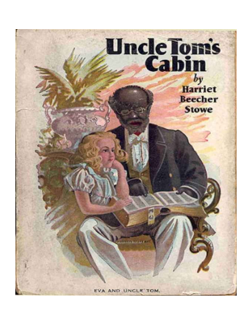
A History of the "Uncle Tom" character
1852 novel
The character in the novel was actually meant to be a rejection of original stereotypes. The character was beaten and ultimately killed by his master because he wouldn't reveal where two females slaves had run away to.
In the American racial context, "Uncle Tom" is a pejorative term for African-Americans that give up or hide their ethnic or gender outlooks, traits, and practices, in order to be accepted into the mainstream.
The term "Uncle Tom" eventually became a derogatory term (this means negative!) for a person who is viewed as a lower class because of their race.
It is NOT a term that is acceptable in our society today.

Slide 19
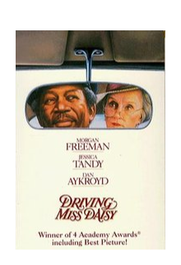
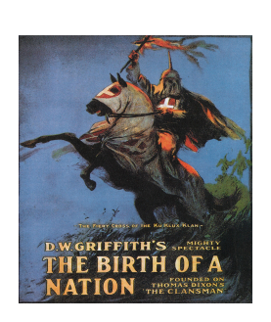
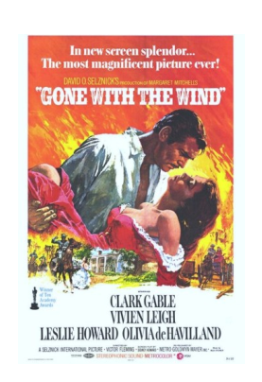
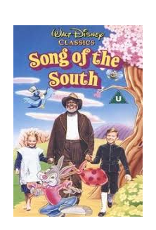


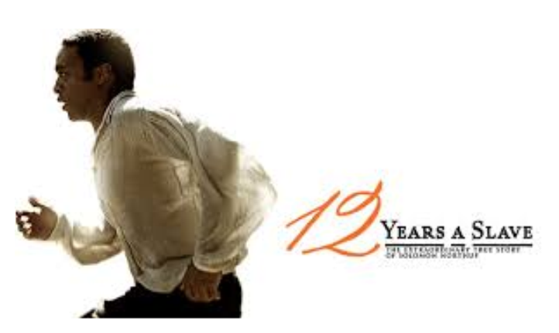

Slide 20
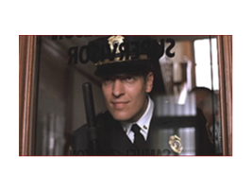
Representation - Prison
Prison is represented as a cruel, inhumane institution that strips individuals of their humanity.
We can also say that the prison system is represented as one of institutionalism.
  "We keep those sentenced to prison in custody, helping them lead law-abiding and useful lives, both while they are in prison and after they are released."
  https://www.gov.uk/government/organisations/hm-prison-service
Task
Create notes to show that the prison in The Shawshank Redemption is represented as cruel and inhumane.

Slide 21
Prison is represented as a cruel, inhumane institution that strips individuals of their humanity.
One of the new prisoners is violently beaten. The diegetic sound of the punches and his crying is overwhelming. The lighting is dark and low key.
This makes it all the more sinister. It's clear the guards do not see the prisoners as human but as punchbags.
There is a low angle POV shot from Andy's perspective as he enters the prison for the first time. He sees the sky vanish and the dark walls of the prison loom over him.
This suggests that he has lost his freedom and that prison is oppressive. Prisoners lack basic human rights such as access to daylight.
Hadley to the new prisoners "You eat when we say you eat..." Prisoners aren't allowed to make the most basic of decisions that a lot of us take for granted such as choosing when they eat.
This supports the idea of prison being an institution because they can't make their own choices.
As the new prisoners enter prison they are stripped of their outside clothes, hosed down and covered in de-lousing powder (which looks like baby talc).
This makes them look similar to babies which suggests they are now no longer in control of their actions and lives. It looks undignified.

Slide 22
Representation - Prison
The prison system is one of institutionalism - its system strives to eliminate the tiniest of hope of freedom from their prisoners.
Shawshank’s system is shown through the character Brooks and through what happens to Red.
Brooks has been in prison too long to know how to function on the outside world
“In here he’s an important man, an educated man, out there he’s nobody.”
His movement is uncertain outside (looking around, shuffling) to indicate he's lost
In his suicide note he calls himself "an old crook" to indicate he identifies himself through his crime, not his humanity
Gripping the seat on the bus, can't let go as he's so scared of the outside world and developments
Camera tracks him outside, he stands out in the frame due to movement, colour of shirt (he doesn't fit in)
When Red and Andy hear the news of Brooks’ death, Red’s reaction is, “He should have died in here”- the implication is that Brooks should have died at home.

Slide 23
Representation - Prison
The prison system is one of institutionalism - its system strives to eliminate the tiniest of hope of freedom from their prisoners.
Red’s parole hearings
Routineness and repetition of his answers (“Yes sir…without a doubt…no danger to society here”) - loss of hope
Close-up of “Rejected” stamp - he's a faulty object, discarded by society.
Viewers can see the cold-blooded murderer in Red no longer exists.
They know he is a changed man, a good man, yet the parole continues to deny him the freedom he deserves.

Slide 24
Representation - Prison
The prison system is one of institutionalism - its system strives to eliminate the tiniest of hope of freedom from their prisoners.
Red is granted parole and released.
What codes can we describe and analyse?

Slide 25
Representations in media content are created by language features such as images, sound, words and so on.
(a) Describe two representations in media content you have studied. 2 marks
Women are represented as...
African Americans are shown to be...
The prison system is represented as...
(b) Explain in detail how language features have been used to create each of these. 10 marks
This means 10 codes with an accompanying piece of analysis
e.g.
Brooks has been in prison too long to know how to function on the outside world
Dialogue, Red says “In here he’s an important man, an educated man, out there he’s nobody” – emphasises that his lack of status outside, and suggests he will not survive in a world he doesn’t understand.

