Slide 1
Section 2 of Exam
Unseen Analysis

Slide 2
Areas to consider
Language
Use of colour
Setting
Cameras shots/angles
Costume
Props
Body Language
Title (font)
Text (tagline, release date)
If there is a release date, consider the month: Christmas – Family; October – Horror; Summer = Big budget, special effects, mainstream
Categories
Genre conventions
Tone Purpose
Does the language ANCHOR any of these?
Narrative
Binary opposition
Todorov
Hero’s Journey
Propp character roles
Enigma codes
Action codes
Institutions
Use of stars?
Use of director’s name?
What sort of films are these stars usually in?
Are they A-list actors?
If a name is on the poster, is it synonymous with quality?
Audience
Preferred reading – is this clear and aimed at anyone in particular?
Differential decoding – does the text unintentionally contain another reading that might appeal to a different type of audience?
Society
Does the image reflect issues/events occurring in society?
How does it do this?
Who will this resonate with and why?
Representation
Places
Countries
Events
Particular types of people

Slide 3
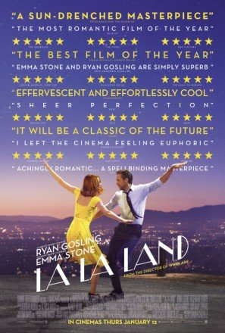
How to Start
Intro (Identify the purpose and the TA)
The film poster for ‘La La Land' appears to have the target audience of______. The purpose is to _______.
Work your way through the key aspects listed in the question, remember to describe, analyse and hook back to audience and/or purpose! I would use sub-headings i.e.
Language
One of the main colours used in the poster is midnight blue. Midnight is a time we associate with romance and lovers, particularly if there are twinkling lights as there are here. This would appeal to young women who stereotypically like the romance genre.

Slide 4
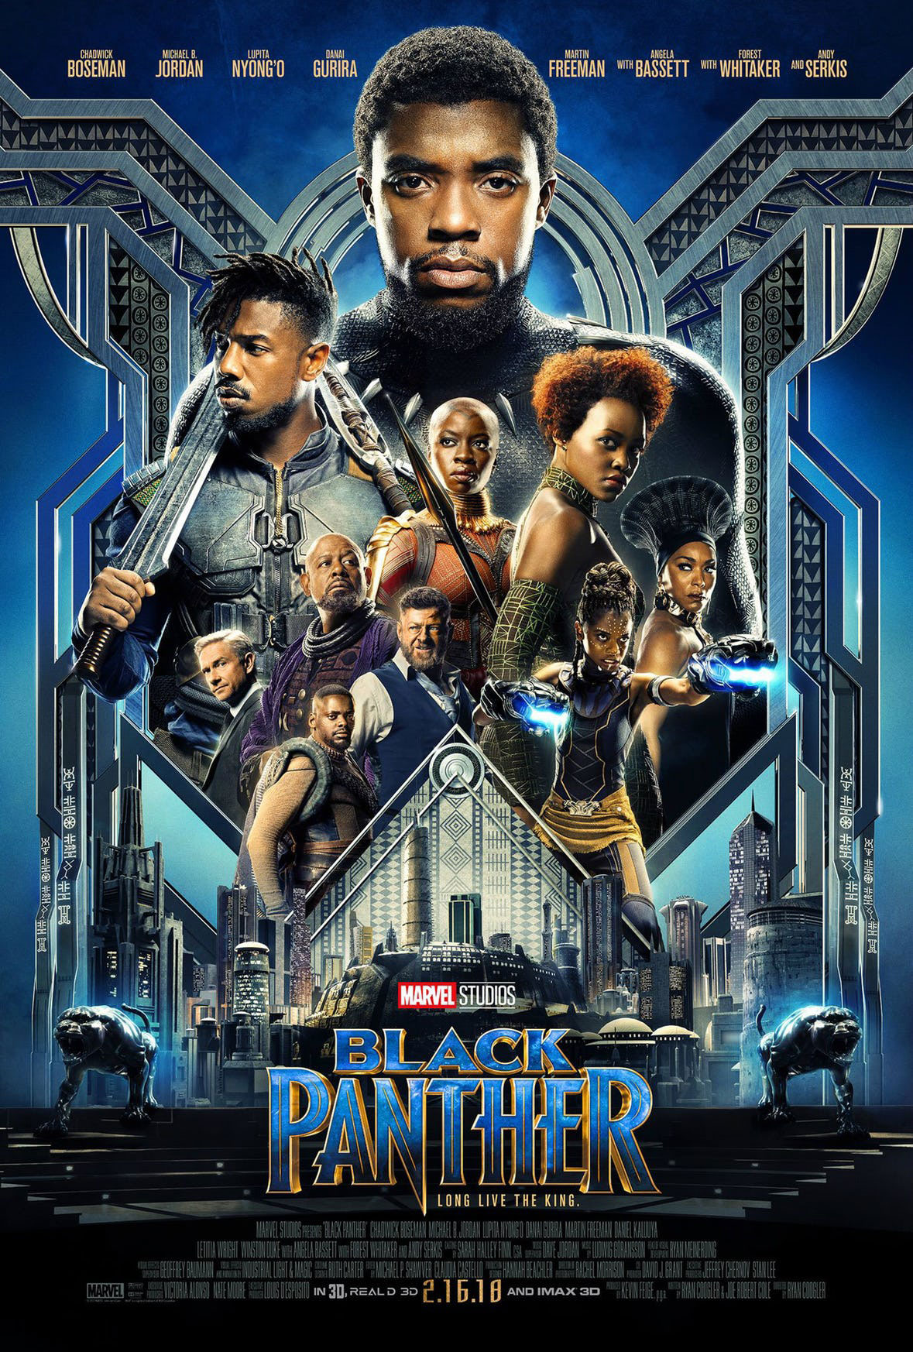
One mark should be awarded for explaining in detail how relevant key aspects of media literacy have been used with particular purposes and/or for specific audiences.

Slide 5
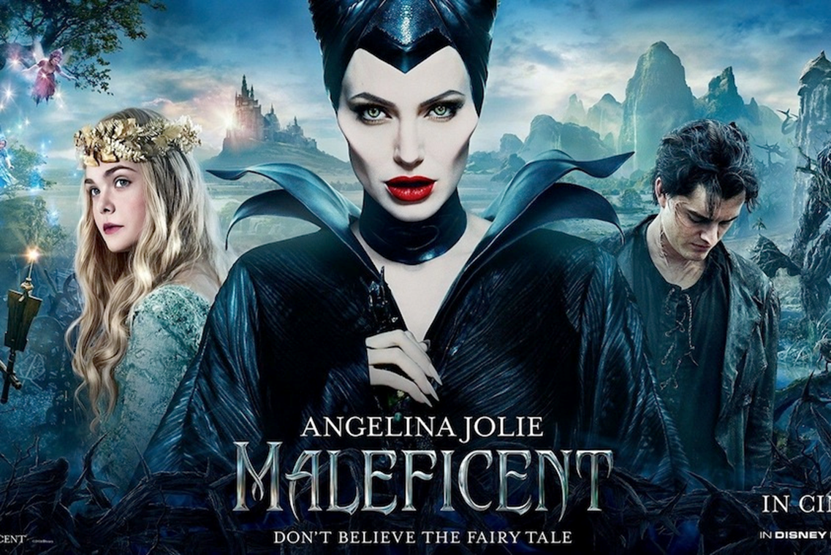

Slide 6
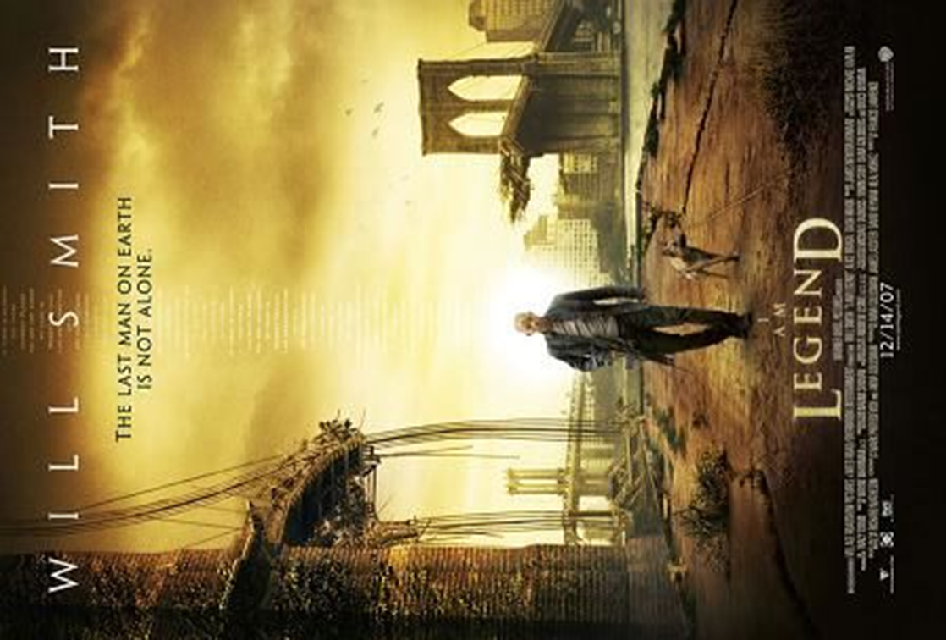

Slide 7
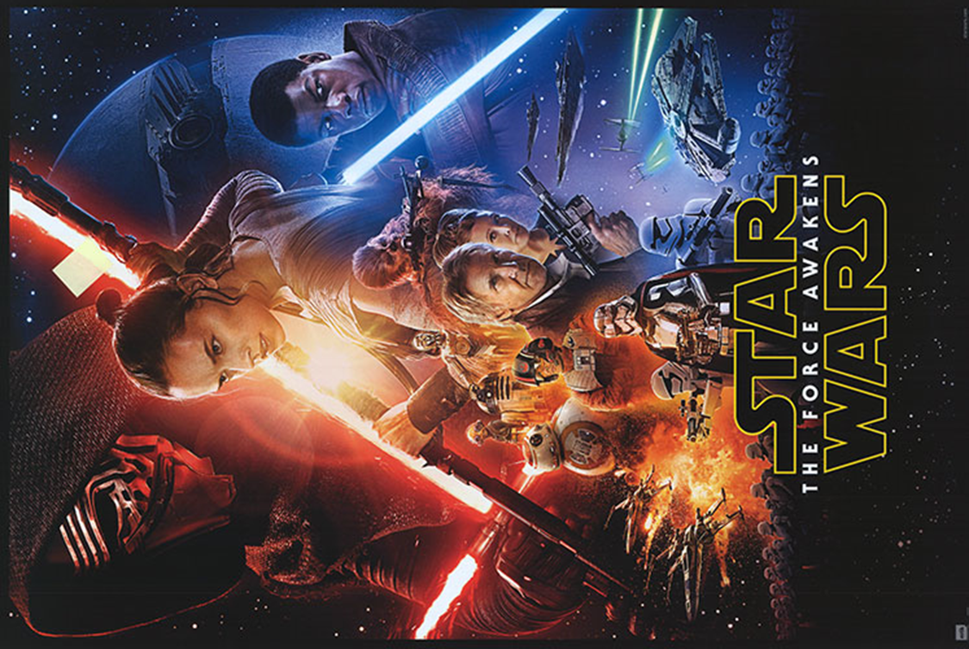

Slide 8
