Slide 1
Role of Media question
The final question in Section One of your exam will be a “role of media” question.
To achieve these marks you will essentially write a little mini essay or developed bullet points.
On the next slide is an important table which highlights the areas the SQA could ask you about.

Slide 2
The Role of the Media
The final question in Section One of your exam will be a “role of media” question.
To achieve these marks you will essentially write a little mini essay or developed bullet points.
Below is an important table which highlights the areas the SQA could ask you about.
Why does the Media exist?
What is its role/function in society?
Meeting Needs | Achieve particular purposes | Influence Attitudes and Behaviours
Entertainment | Profit | Intentionally
Education | Promotion | Unintentionally
Information | Public Service

Slide 3
Categorise each for ROM
Role of media | Blazed | Gorilla | Smoking Kid | Shawshank
meeting needs: entertain
meeting needs: educate
meeting needs: inform
Influence A/B: intentional
Influence A/B: unintentional
meet a purpose: profit
meet a purpose: promotion (in self-interest of business or individual )
meeting a purpose: public service

Slide 4
What we will look at
‘Second A Day’ – Save the Children
Impact of war on children
https://www.youtube.com/watch?v=RBQ-IoHfimQ
‘Boys Don’t Cry’ – White Ribbon
The effects of toxic masculinity
https://www.youtube.com/watch?v=fjo-hwAKcas
‘Gorilla’ – Cadbury’s
Promoting Cadbury’s Dairy Milk
https://www.youtube.com/watch?v=TnzFRV1LwIo

Slide 5
A ‘Big Picture’ Question
The Role of the Media is:
Far –reaching (societies/cultures/continents)
Sometimes hard to define
Looking at things from a sociological perspective

Slide 6
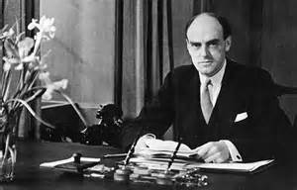
Media plays a wide-ranging role
At a basic level you could argue that the media exists to Entertain.
This builds on the Reithian public service broadcasting ethos of
‘To inform, to educate and to entertain’
How many texts can you think of with these purposes?
Lord John Reith was the puritanical Scotsman who was the first General Manager of the BBC on its establishment in 1922 and its first Director General when it became a public corporation in 1927.

Slide 7
Other roles
To perpetuate/maintain ideologies
Translation: Institutions creating media products which promote the way they see life and their interpretations and ideals.
These institutions are often controlled by other institutions.
A way to control a major facet of society

Slide 8
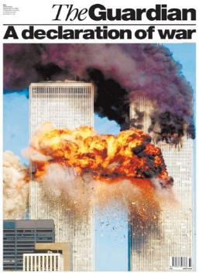

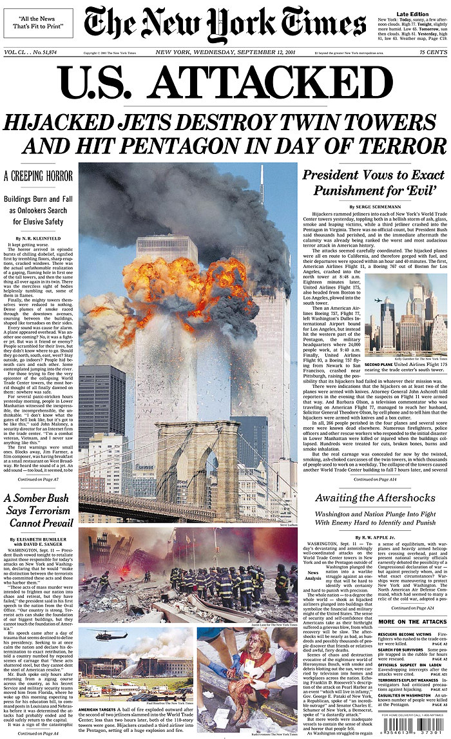
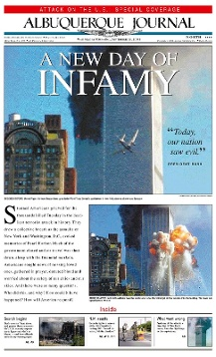
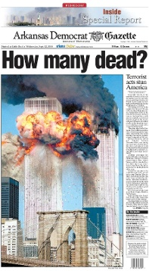

Slide 9
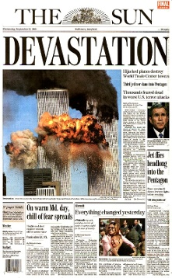
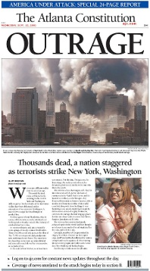
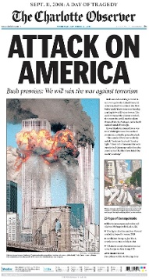

Slide 10
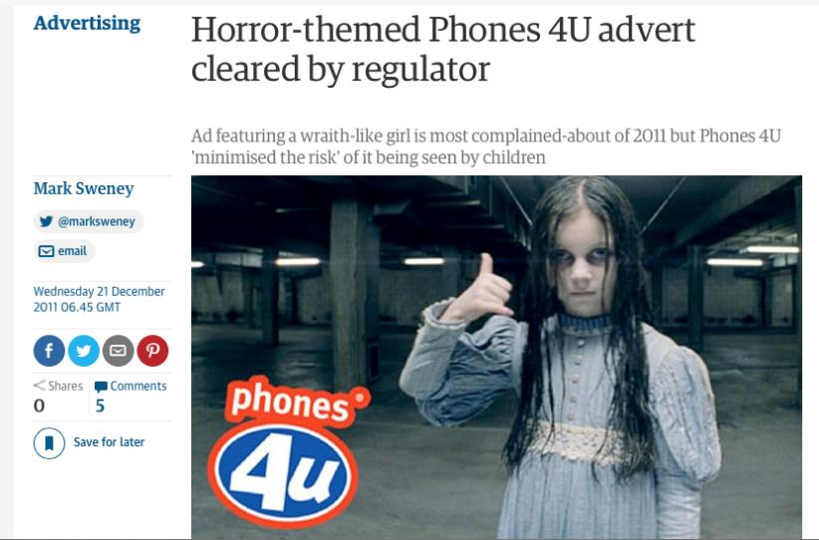
To entertain? / Make a profit?
601 complaints to the ASA
Most complaints for any ad in 2011

Slide 11
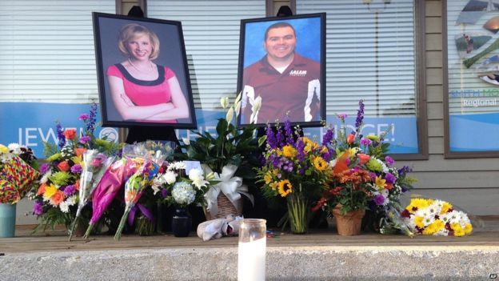
Are there costs to ‘Entertainment at any cost’?
Medias need to get ‘clicks’, ‘hits’ and ‘likes’ comes at the cost of humanity’s humanity?
E.g.
Recent shooting of journalists by ex-reporter
Social media buzz and about video
Is this a loss of ethics? Our moral compasses broken?
Entertainment at the expense of others

Slide 12
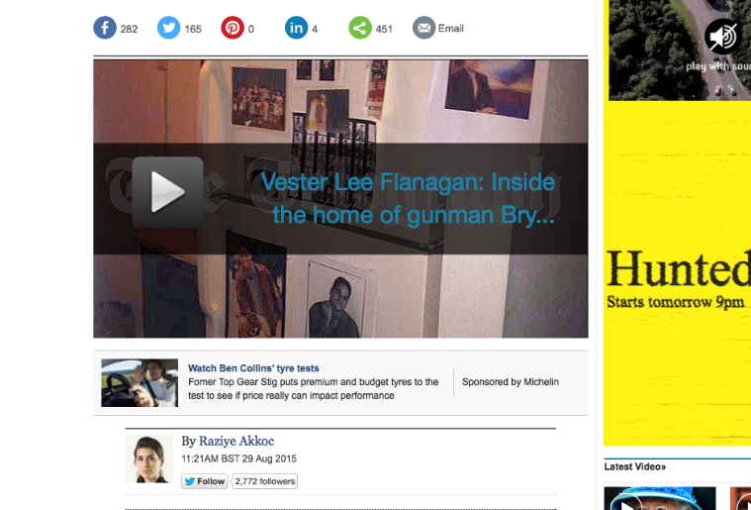
To Inform? To Educate? To Entertain?

Slide 13
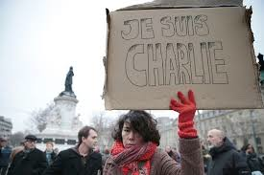

To make a profit – how far do you go?
To be the best informant – how far do you go?
Did the French media put lives at stake?
Je suis Charlie campaign buzz

Slide 14

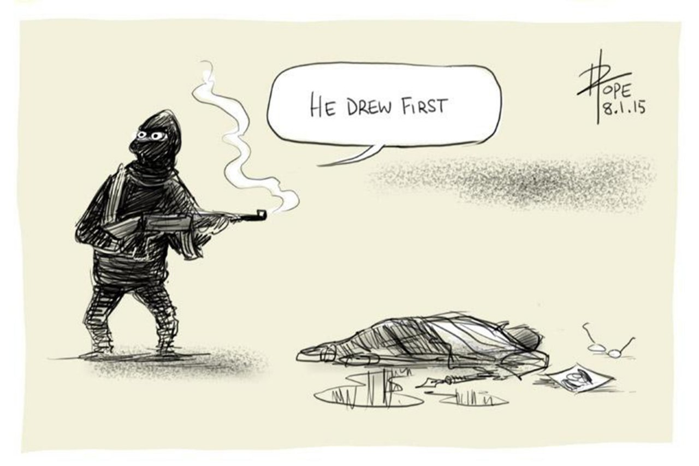
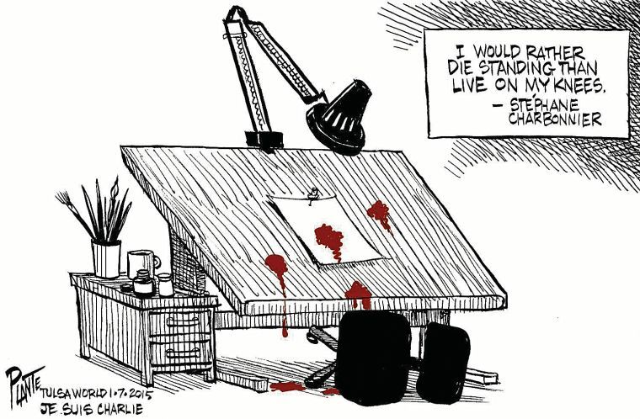
To influence our attitudes and behaviours?
To perpetuate ideologies?
To make a profit?
To maintain a status quo?
To educate?

Slide 15
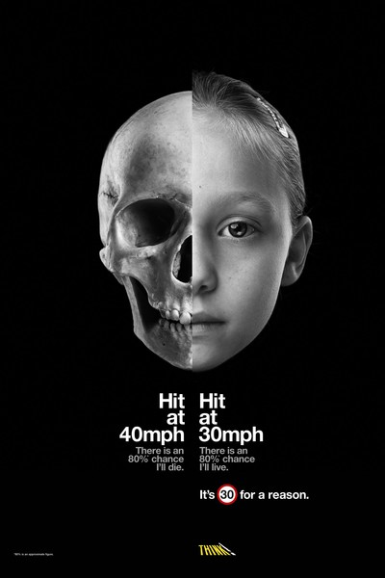
Is the shocking tone and hard-hitting style necessary? Good, even?

Slide 16

Offensive? Beneficial? Both?

Slide 17

The media using media

Slide 18
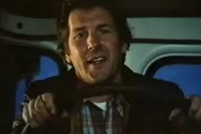
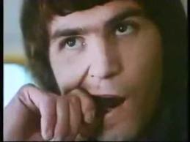
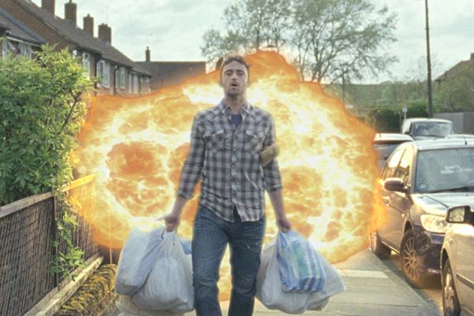

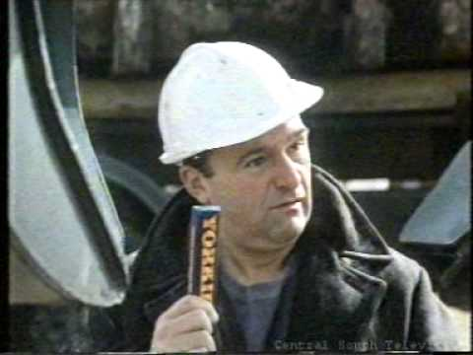
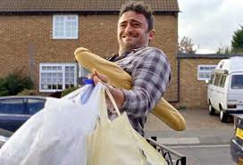

Perpetuating ideologies?
Make a profit?
https://www.youtube.com/watch?v=iMDjLNxI9vE
https://www.youtube.com/watch?v=0pLZwMJMUR4

Slide 19
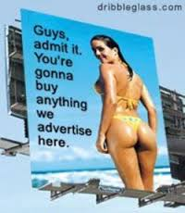
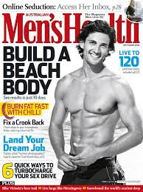





How might maintaining an ‘elite’ benefit the media?

Slide 20
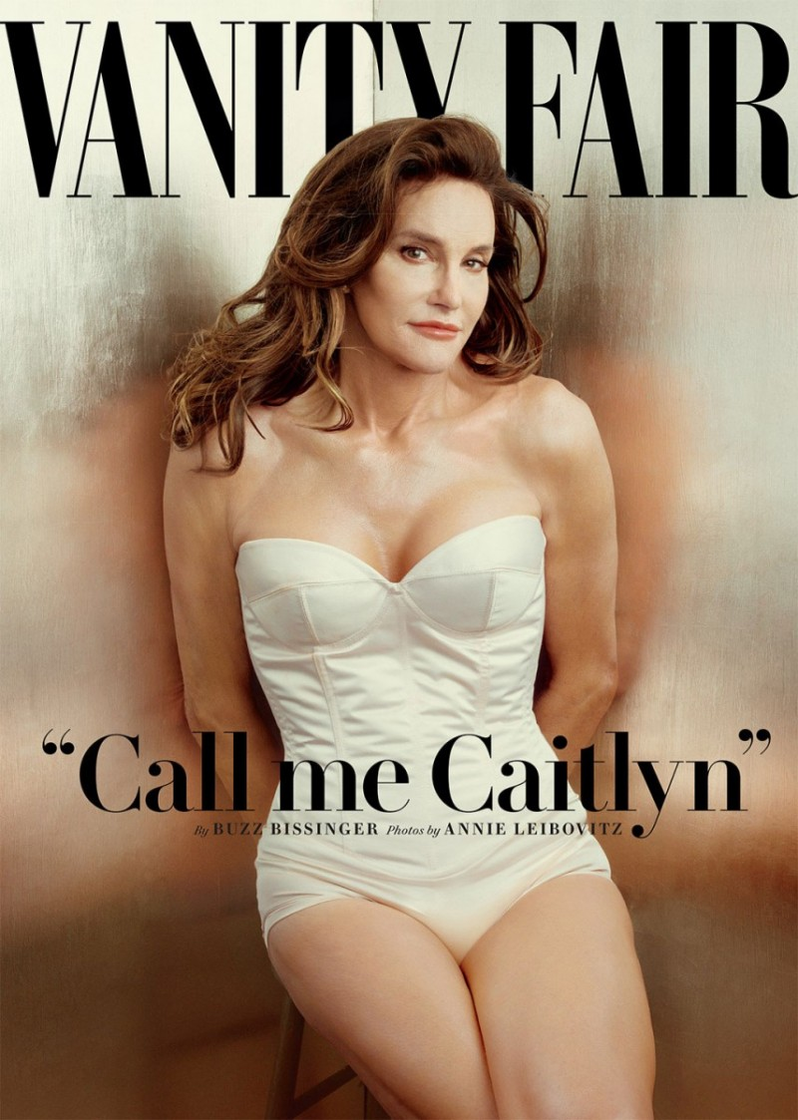
To influence attitudes and behaviours?
To make social change?
A public service?
To make a profit?

Slide 21
Final thoughts
We put an incredible amount of trust in Media
It shapes every facet of our lives
We affect the media too
Reciprocal and cyclical
A balance of power? e.g. Checks on government
BBC publically owned vs. privatisation e.g. Rupert Murdoch/News of the World
Who will watch the watchers?
Quis custodiet ipsos custodes?

Slide 22
Role of Media: Assessment
Choose 1 genre/medium for you to focus on
Suggestions:
4 Charlie Hedbo political cartoons
4 product ads (eg. beauty/sweet/food/drink ads). (Can be print or moving image)
4 magazine covers
4 public service ads (can be print or moving image)
4 examples of any other appropriate genre/medium

Slide 23
Role of Media: Assessment
Paragraph 1 – Categorise your texts
  Brief description of the text (main message/what it’s about)
  Medium (eg. Print, television, film…)
  Genre (eg. Sweet ad, political cartoon, magazine cover…)
  Purpose (At least 2 – inform, persuade, entertain, make a profit…)
  Tone (eg. Serious, dark, hard-hitting, light-hearted, humorous…)

Slide 24
Role of Media: Assessment
Paragraph 2 – Define the role of the media
Based on the texts you’ve selected, what do you think the role of the media is?
  Do the texts prove the role of the media is to meet society’s needs?
  Do they suggest that the role of the media is to achieve particular purposes?
  Do they reinforce the idea that the role of the media is to influence attitudes and behaviours?
  Is it a combination of the above?
  Explain your conclusions, referring to your texts as evidence.

Slide 25
Role of Media: Assessment
Paragraph 3 – Analysis
How do these texts aim to be effective?
  Do you think they successfully meet their purpose(s)?
  How?...
    Through language codes? (cultural and technical codes)
    Through generic conventions
    Through a particular tone
    Through representations? (selection, portrayal, stereotypes, ideologies…)
    Through societal factors? (time/place, current events, historical events, fads, trends…)

Slide 26
Role of Media: Assessment
Paragraph 4 – Evaluation
Evaluate the role of media overall based on your opinion regarding what the role of the media is (stated in paragraph 2)
  You should come to a final conclusion about what the role of the media really is, based on your earlier arguments.
  Finally, you need to argue one side of the issue –
    Is this a good or a bad thing?
    Are there strengths and/or weaknesses involved?
    Positives and/or negatives?
    Advantages and/or disadvantages?
    Opportunities or restrictions?

Slide 27
The Role of the Media
Why does the Media exist?
What is its role/function in society?
Meeting Needs | Achieve particular purposes | Influence Attitudes and Behaviours
Entertainment | Profit | Intentionally
Education | Promotion | Unintentionally
Information | Public Service

Slide 28
How to prepare
There are three stems:
1. Meeting Needs
2. Achieve particular purposes
3. Influence Attitudes and Behaviours
Each stem can be sub-divided:
1. Entertainment
Education
Information
2. Profit
Promotion
Public Service
3. Intentionally
Unintentionally
When you answer the final 8 marker in English you may have a list of common features and you will have jotted down poem/parts of the play or novel which share these features.
Take the same approach!

Slide 29
Categorise each ad for ROM
Role of media | PSA: Second A Day | PSA: Boy’s Don’t Cry | Cadbury’s - Gorilla
meeting needs: entertain
meeting needs: educate
meeting needs: inform
Influence A/B: intentional
Influence A/B: unintentional
meet a purpose: profit
meet a purpose: promotion (in self-interest of business or individual )
meeting a purpose: public service

Slide 30



What are Product advertisements?
A way for a company or individual to promote a product, thus making a profit
Paid for by companies (Unilever, Coca-cola, L’Oreal)
Most common medium: TV, print, radio, internet
Product advertising is the art of building and maintaining product awareness with potential buyers. A good advertising program informs potential customers on why they need the product, how it is used and the benefits derived from its use. A successful program also tells the consumer how the product is better than similar offerings by competitors.
Purpose: to promote a product to the consumer with the intent to sell the product, often achieved through entertaining the audience

Slide 31
The ‘Gorilla’ ad
Watch a few times through then look back at the Role of Media table – which roles of media does this advertisement fulfil?

Slide 32
Questions
Summarise the narrative (what happens) – this won’t take long at all!
What is the purpose of this ad? Give evidence
Who is the target audience for this ad? How have they been specifically targeted?
What two different tones are found in this ad?
This ad is very creative. How has the director used technical and cultural codes to anchor each tone? (Give at least two codes for each tone)

Slide 33
1. The narrative
The ad begins with the caption ‘A glass and half full production’ appearing and disappearing on screen as the camera slowly pans to the right.
A close up shot reveals the face of gorilla, he is breathing heavily and staring intently. At the same time Phil Collins’ ‘In the air tonight’ starts playing in the background. The music is diegetic.
It is a full 40 seconds before the camera zooms out and the audience can see the gorilla is at a drum kit, ready to hit the beat when the drums begin in the song.
The gorilla is clearly relishing the moment as he nods along to the beat, thrusts his chest and his chin out.
The camera zooms out further to reveal he appears to be in a recording studio, the iconic purple of the Cadbury’s wrapper is the primary colour of the advert.
The screen fades to purple, an image of a Dairy Milk bar appears as well as the caption: “A glass and a half full of joy.”

Slide 34
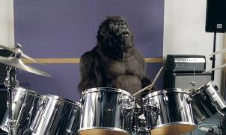
2. Purpose (Role of Media)
To achieve a particular purpose: the promotion of a particular brand of chocolate
To achieve a secondary purpose: to sell the product and therefore make a profit
To meet a need: entertain the audience: unexpected, surreal, enigmatic

Slide 35
3. The target audience
Chocolate tends to be something universally liked and it would be acceptable to say, in this case, that the advert is for a universal audience – there is something there for everyone.
The ad first aired at 8pm, during an ad break for ‘Big Brother’ which suggests, initially at least, they were targeting adults
The advert features a well known song ‘In the air tonight’ – this song was first released in 1981 suggesting that the advert may resonate with those in their 50s
The advert features a man in a gorilla costume - children

Slide 36
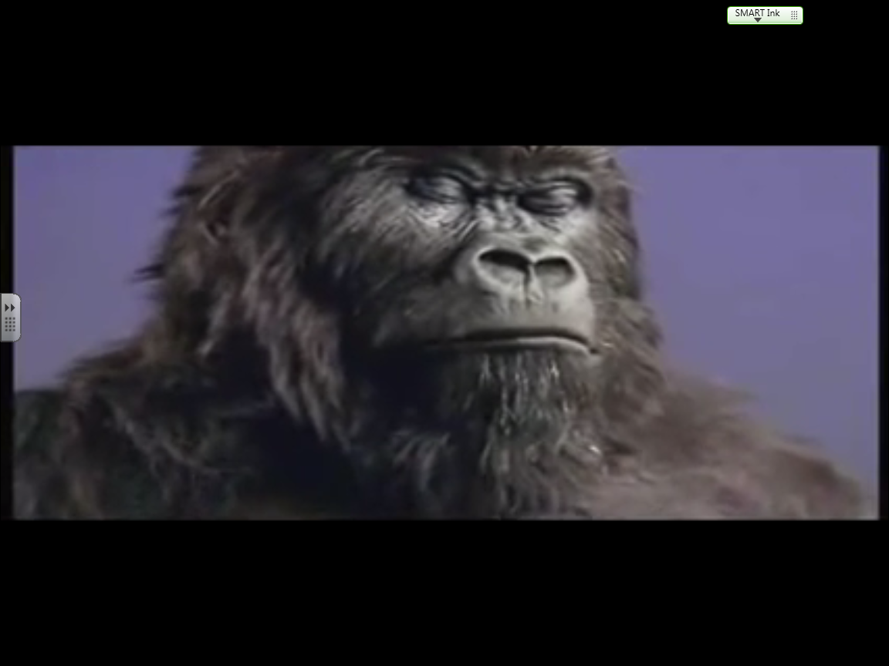
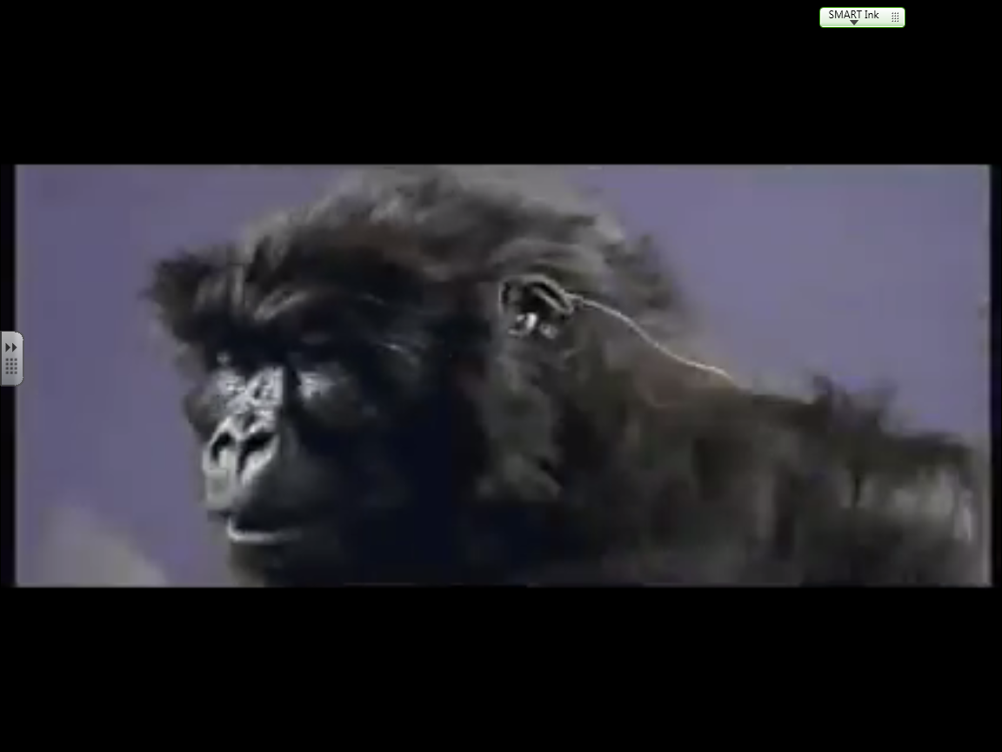
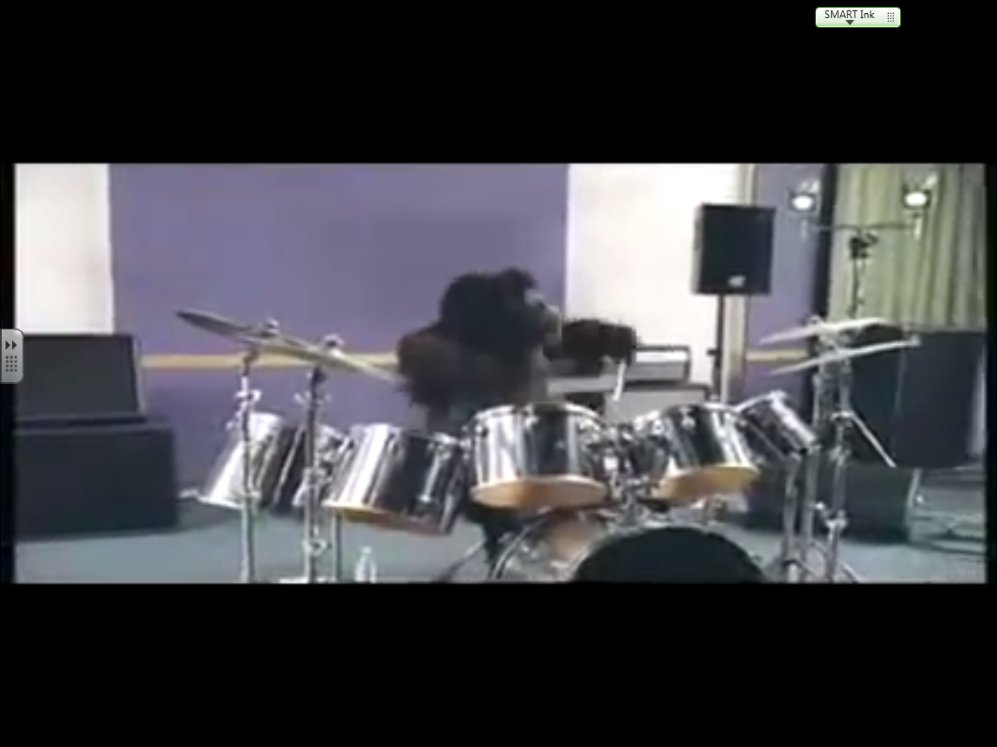
4. Tones
Serious
Surreal
Light-hearted

Slide 37
5. Film language – You must always consider link to purpose (profit/promotion) and meeting needs (entertainment)!
Cultural | Denotation/Connotation | Technical | Denotation/Connotation
Facial Expression |  | Camera work
Colour |  | Diegetic sound effects
Setting |  | Logo
Dialogue |  | Tagline
Behaviour

Slide 38
5. Film language – You must always consider link to purpose!
Cultural | Denotation/Connotation | Technical | Denotation/Connotation
Facial Expression | Serious and contemplative Chin up = pride Eyes closed = in the zone Snarl = Back off, space required, genius at work | Camera work | CU of gorilla tilting head up, LA suggest gorilla is in control of the situation. Camera slowly zooms out to reveal MCU of gorilla at drum kit – builds suspense because we don’t know what the gorilla is doing.
Colour | Purple background synonymous with Cadbury, subtle product placement | Diegetic sound effects | “In the Air Tonight” by Phil Collins, features one of the most iconic drum riffs of all time that is instantly recognisable
Setting | Recording studio to enhance surreal feel, not a location we expect (zoo, jungle) | Logo | The glass half full of milk - to show that Cadbury’s is one of a kind, connotes quality, luxury
Dialogue | “I’ve been waiting for this moment all my life” anchors the importance of the moment for the gorilla | Tagline | A glass and a half full of joy – connotes happiness, enjoyment, a mind set -
Behaviour | See facial expression

Slide 39
6. Style
A surreal and ultimately light-hearted tone engages a universal audience and promotes the product:
  Use of a dramatic soundtrack (iconic song of the 80s)
  Slow reveal of action through use of camera (creates suspense)
  Body language of gorilla (intense, serious, professional)
  Use of purple (subtle brand reinforcement)
  Logo (provides audience with “direction” i.e. enjoy this, don’t think about it on a serious level)

Slide 40
Exam question
Successful media content meets the needs of its audience(s).
(a) Describe two needs of the audience(s) for media content you have studied. (2)
(b) Explain in detail how media content was used to meet each need. (8)

Slide 41
Christmas Ad Questions
Summarise the narrative (what happens) – this won’t take long at all!
What is the purpose of this ad? Give evidence
Who is the target audience for this ad? How have they been specifically targeted?
What tone/s is/are found in this ad?
How has the director used technical and cultural codes to anchor the tone/s? (Give at least two codes for each tone)

Slide 42
Public Service Announcements
Learning Intentions:
Understand the purpose and conventions of PSAs
and how they intend to influence the attitudes and behaviours of audiences
Success Criteria:
Analyse language codes and conventions in a range of PSAs
Research its affect on audiences

Slide 43

What are Public Service Announcements?
PSAs are a form of advertising
Sponsored by non-profit organisation (government, M.A.D.D., Wateraid, UNICEF, National Trust, World Vision…)
Most common medium: TV, print, radio
Purpose: to communicate or reinforce pro-social information to the public with the intent to change attitudes and behaviour

Slide 44
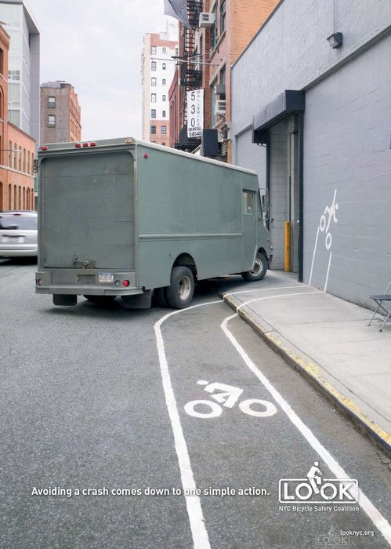
Examples of PSAs
Promote flu jags
Advertise the warning signs of stroke
Raise awareness of cyber stalking
Promote healthy eating
Advocate cycle safety
End discrimination
Publicise the negative effects of smoking
Encourage others to watch out for elderly neighbours
Advertise help groups/phonelines
Urge people to donate blood

Slide 45
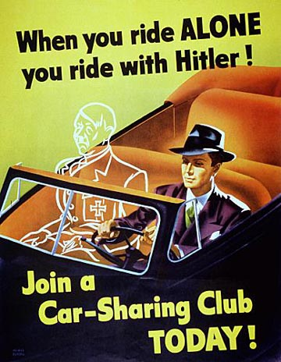
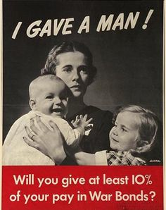
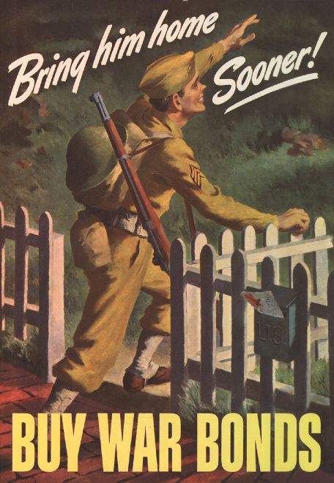

Influence Attitudes and Behaviour
PSAs are a good example of media being used to affect the way we think, the decisions we make and how we behave
Historically, they go back to WW2

Slide 46
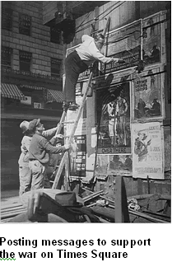

Slide 47



PSAs: Post WW2
After the War, PSAs were used to educate the public on a broader range of issues.

Slide 48

Why are PSAs on TV/in Print?
Television stations are required to serve their community and PSAs are one way to do this
In 1934, the FCC in America (Federal Communications Commission) declared that broadcasters "should serve the public interest, convenience and necessity.”
Many non-profit and social service agencies have discovered that advertising on TV or in print - and now via the internet - is an effective way to reach large numbers of people, and can be highly effective in changing attitudes and behaviors.

Slide 49
When are PSAs aired?
Because the producers of a PSA do not pay for the time the PSA is aired, they cannot control when or how frequently it gets shown on TV or radio or placed in a newspaper or magazine.
Media outlets decide which types of PSAs are appropriate for their target audience.
Many television affiliates and cable networks employ PSA directors who review all the PSAs provided by nonprofit organizations and choose which ones to schedule
Stations tend to place PSAs in time no one else has purchased. For example, you'll see PSAs more often early in the morning or late at night, when few viewers are watching.
You may also see PSAs during the local evening news when stations are trying to communicate their goodwill to community leaders.

Slide 50



PSAs in America
Tend to focus on health and safety issues such as obesity or gambling addiction.
Another common American PSA: being green/pro-environment
The occasional use of celebrities to generate more ‘buzz’

Slide 51

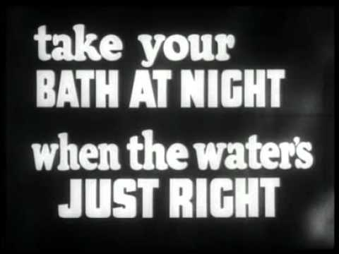
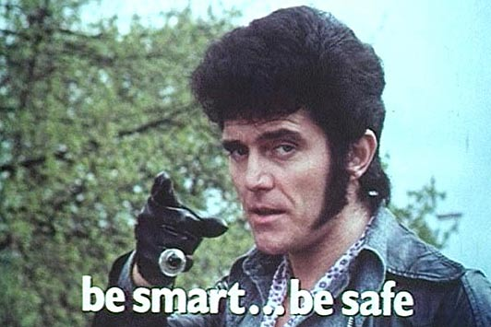
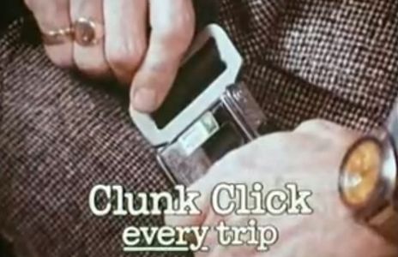

PSAs in the UK
Sometimes called Public Information Films (PIF)
They cover a wide range of subjects, mostly health, but also include animal cruelty, pro-environment, crime prevention and voting.

Slide 52
PSA conventions
COPY THIS DOWN
Short (30 – 60 secs)
A clear message: informing audiences
A call to action: urging them to change
Use of emotion
Entertaining/Attention-grabbing techniques
Based on facts
A tagline
Institutional identity (logos, etc.) concealed until end

Slide 53
Questions
Summarise the narrative in 2-3 points
What is the purpose of this ad? Give evidence
Who is the target audience for this ad? How have they been specifically targeted?
What two different tones are found in this ad to influence attitudes and behaviours?

Slide 54
Q5. How are technical and cultural codes used to anchor each tone? (Give at least two codes for each tone)
The tones we have identified are…
Paired task: You must take the time to explain how technical AND cultural codes are used to create EACH tone.
Unsatisfactory work will not be accepted.
Satisfactory work will cover 4 codes.
Excellent work will cover more.

Slide 55
Film language
Cultural | Den/Con | Technical | Den/Con
Facial Expression |  | Camera work
Colour |  | Non-diegetic sound effects
Setting |  | Captions
Dialogue |  | Tagline
Behaviour |  | Editing

Slide 56
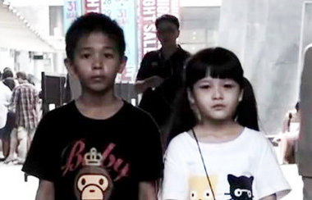
“The Smoking Kid” https://www.youtube.com/watch?v=aHrdy6qcumg
made for Thai Health Promotion Foundation
ad agency: Ogilvy Thailand
production costs: $5000
uploaded to YouTube: 5 million views within 10 days
no social media spend

Slide 57
Why was this PSA made?
Thai Health Promotion Foundation (THPF) wanted to combat the scourge of smoking
Up until the release of ‘Smoking Kid’ calls to the “1600 Quitline” were considerably low
THPF wanted to avoid shock tactics and emotional cues as these had not been effective in the past, sometimes the most powerful voice can be your own
The voice of smokers served as the warning thus creating a "self-awakening” moment
https://www.youtube.com/watch?v=aHrdy6qcumg

Slide 58
Film language
Cultural | Den/Con | Technical | Den/Con
Facial Expression | All the smokers’ faces are blurred out dehumanises the smoker so that the audience can project themselves on to the character and put themselves in that situation. | Camera work | POV shot – smoker looking down at info sheet with QUITSMOKING number creates connection between audience and message, feels personal – a note written just for “you” the smoker
Colour | Grey filter creates a depressing mood suggests that life is being drained out of smokers/Thailand | Non-diegetic sound effects | Drums kick in as message displayed on screen suggests that the message is having an emotional impact on the smokers, and the audience. Highlights how serious the issue is.
Setting |  | Captions
Dialogue | Smokers list off negative effects of smoking to kids coming from smokers themselves; more likely to listen to ourselves, avoids being hard hitting | Tagline
Behaviour |  | Editing | Montage shows a series of Thai people smoking to anchor the scale of the smoking problem in Thailand = many shots = many smokers

Slide 59
Past paper question 2016
Some media content is intended to perform a public service.
(a) Describe how media content you have studied is intended to perform a public service. (4)
(b) Explain how at least one key aspect is used to achieve this public service. You should refer to at least one of: language, narrative, representation, categories, institutions, audience. (6)

Slide 60
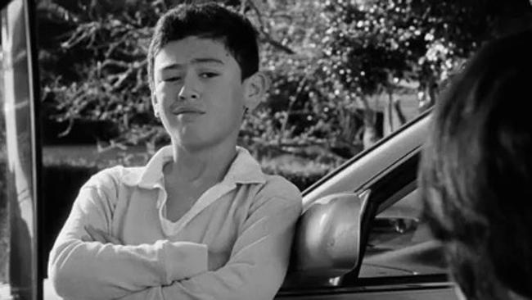
“Drug Driving: Blazed in Aotearoa”
made for the New Zealand Transport Agency (NZTA)
ad agency: Clemenger BBDO
director: Oscar-nominated Taika Waititi
production costs: $250,000
aired on the Maori television stations and placed on many of New Z’s popular websites.
uploaded to YouTube: viewed over 2.3 million times since Sept 13
no social media spend

Slide 61
Why was this PSA made?
NZTA found that Maori men and women were 50% more likely to smoke cannabis than New Zealand’s general population
The NZTA wanted to combat the idea so-called ‘sensible stoners’ have that smoking cannabis does not affect one’s driving skills
National poll: 1/3 of NZ citizens thought drug driving safe. Many thought that they were in fact better drivers while high on Cannabis
NZTA wanted to Avoid the classic road-safety, hard-hitting consequences PSA since there is not a lot of hard evidence on drug driving in NZ
Instead, the aim of this PSA is to unsettle people’s confidence about drug driving and seed some doubt about whether they are really as safe as they think they are while driving on cannabis

Slide 62
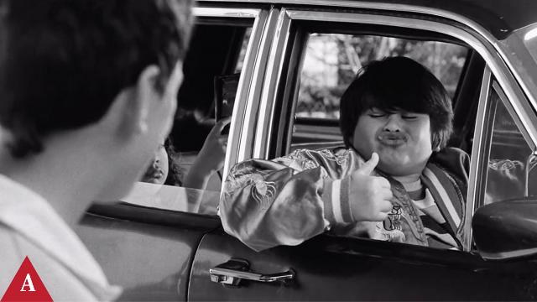
“Drug Driving: Blazed in Aotearoa”
"Blazed" New Zealand Transport Agency for Maori television

Slide 63
Questions
Summarise the narrative (what happens) in 3-5 points
What is the purpose of this ad? Give evidence
Who is the target audience for this ad? How have they been specifically targeted?
What two different tones are found in this ad?
This ad is very creative. How has Taika Waititi used technical and cultural codes to anchor each tone? (Give at least two codes for each tone)
(HIGHER ONLY) This ad has been filmed in a cinematic style . In what way is this ad cinematic in style and why has this style been used?

Slide 64
1. Summary of ‘Blazed’ PSA
The ad shows three young boys waiting outside a house for their fathers to finish ‘blazing’
They begin comparing whose father is best at driving whilst high
The children provide observational insights by acting out humorous scenarios of their dads behaviour while drug driving
At the end, we see the tone shift from comical to contemplative as the tagline appears: “Drug driving. Is it really that safe?”

Slide 65
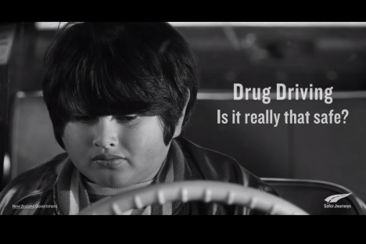
2. Purpose (Role of Media)
To influence attitudes and behaviours: convince viewers to
think twice about their ability to drive after smoking cannabis
To promote: the idea that drug driving is dangerous
To provide a public service: send a
pro-social message deterring drug
driving and thus keeping roads
safer for all New Zealanders
To inform: dangers and risks
involved in drug driving

Slide 66
3. Target Audience
Maori men
Maori women
Maori boys
International audience (social media)

Slide 67
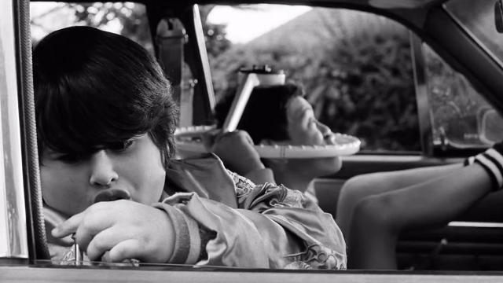
4. Tone
Comical/humorous
Nostalgic
Serious
Reflective/contemplative

Slide 68
Why did Waititi take a humorous approach?
The Maori’s relaxed view on driving under the influence is key
Shock and scare tactics would be too aggressive for this target audience
The humour is engaging and disarming
Allows for the effective rhetorical question which plants seeds of doubt
They (NZTA) lacked concrete drug driving statistics and needed to consider alternative approaches

Slide 69
5. Film language
Cultural | Den/Con | Technical | Den/Con
Facial Expression | From comical to thoughtful/serious | Camera work | Close up on facial exp to emphasise doubt and worry Establishing long shot – to emphasise setting
Colour | Shot in black and white lends gravity to reinforce serious tone and message | Diegetic sound effects | Laughter - We hear boys before we see them. Anchors humorous tone
Setting | Suburban neighbourhood, bungalow house with sedan car to emphasise the ‘normal’ lifestyle in Maori communities | Logo | Small and unobtrusive logo of NZTA so as not to distract from facial exp and understand main message.
Dialogue | Use of kiwi slang ‘skux’ and ‘chur’ to anchor relaxed tone and target Maori audience | Tagline | Bold, clear, short = to effectively deliver main message. Rhetorical Q anchors contemplative tone.
Behaviour | Horsing around, mimicking fathers to anchor cheeky and innocent representation. Also shows their impressionable nature.

Slide 70
Film language
Cultural | Denotation/Connotation | Technical | Denotation/Connotation
Facial Expression |  | Camera work
Colour |  | Diegetic sound effects
Setting |  | Logo
Dialogue |  | Tagline
Behaviour

Slide 71
6. Style
A cinematic style gives this PSA a sharp and polished appearance in order to anchor a relaxed/comical tone and engage a laid-back target audience (Maori men)
The cinematic style was achieved through C+T codes:
  Use of montage editing (typical of comedy films)
  Black and white filming (gives a ‘Hollywood’ feel)
  High-key lighting (bright, clear, sharp)
  Slow, panning camera (calm and relaxed)
  Non-diegetic soundtrack for montage scene (enhance the humour)

Slide 72
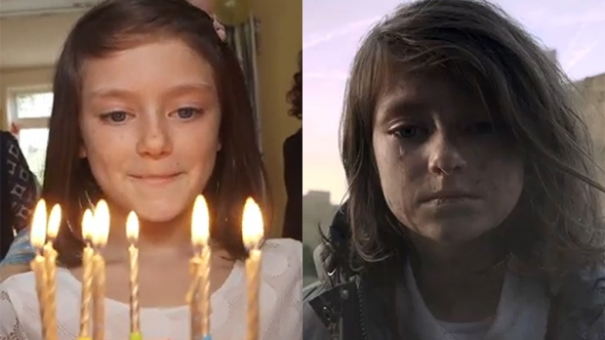
If London Were Syria
If London Were Syria (2014), titled on YouTube Most Shocking Second a Day Video, is a 93-second charity commercial, created by Don't Panic London for Save The Children UK, marking the third anniversary of the Syrian Civil War.
It features a young British girl experiencing the effects of a hypothetical civil war on the streets of London. Everything depicted in the video was based on the factual accounts of children in Syria.
The video's purpose is to depict what life is like for kids as war erupts in their country, in order to bring attention for kids involved in the ongoing Syrian Civil War.
The video was shot over the course of two days, and combines the second-a-day and photo-a-day video formats, featuring a young girl's life as it progresses from normal to complete chaos in the course of a year.
https://www.youtube.com/watch?v=RBQ-IoHfimQ

Slide 73
Questions
Summarise the narrative (what happens) in 3-5 points
What is the purpose of this ad? Give evidence
Who is the target audience for this ad? How have they been specifically targeted?
What two different tones are found in this ad?
This ad is very creative. How has the director used technical and cultural codes to anchor each tone? (Give at least two codes for each tone)

Slide 74
If London Were Syria
Narrative
In the opening scene, the girl is at her birthday party, with her parents and friends near her, and a cake with candles in front of her. She is asked to make a wish.
Over the next few days, she continues to live an ordinary life with loving family and friends, but soon London is engulfed in war.
What do we see next?
_____________________________________________________________
_____________________________________________________________
_____________________________________________________________
By the end of the video, she has lost her father while running with her mother.
On her next birthday, she is seen at a hospital bed and is again presented by her mum with a cake and a candle and asked to make a wish.
The video ends with the line "Just because it isn't happening here doesn't mean it isn't happening.“
It is revealed at the end that the video is based on true stories of what children living through the Syrian Civil War experienced, and highlights the work of Save the Children to improve the lives of children in Syria and around the world.

Slide 75
Purpose
What is the PURPOSE of this ad?
Justify your choices with evidence from the ad.
Meeting Needs | Achieve particular purposes | Influence Attitudes and Behaviours
Entertainment | Profit | Intentionally
Education | Promotion | Unintentionally
Information | Public Service

Slide 76




Purpose: to highlight the ongoing conflict in Syria and raise public awareness.
Meeting Needs | Achieve particular purposes | Influence Attitudes and Behaviours
Entertainment | Profit | Intentionally
Education | Promotion | Unintentionally
Information | Public Service

Slide 77
Film language
Cultural | Denotation/Connotation | Technical | Denotation/Connotation
Facial Expression |  | Camera work
Colour |  | Diegetic sound effects
Setting |  | Logo
Dialogue |  | Tagline
Behaviour

Slide 78
National 5 Role of Media Q
Explain in detail how media content you have studied might influence people’s behaviour or attitudes (10).
Aim for 10 marks (one bullet point for each mark)
Hint: discuss conventions of PSAs in “The Smoking Kid” and “If London Were Syria” and how cultural and technical codes have been used to influence attitudes and behaviours
Don’t forget to discuss target audience – why have they been targeted and how have they been targeted?

Slide 79
Sample response structure
Explain in detail how media content you have studied might influence people’s behaviour or attitudes (10).
Introduce the ad(s): name, director/production company, year, country, genre (PSA/charity ad)
What role of media does the ad aim to achieve? (eg. influencing…)
Brief explanation of ad: what happens and what is it about?
Was it a success? Give evidence (how many views?)
Target audience – who, why were they targeted and how were they targeted?
- The Smoking Kid – reducing smoking numbers; increasing calls to quit line; use of ‘own voice’ to help influence them
- If London Were Syria – ‘clickworthy’ title (Most Shocking One Second A Day Video’); taking familiar British scenes from everyday life and making them worse and worse; girl’s direct look into camera
List the technical and cultural codes used to influence the behaviour and attitudes of the target audience
ANSWER THE QUESTION – ANY POINT YOU MAKE MUST EXPLAIN WHAT HAS BEEN USED, HOW IT HAS BEEN USED, WHY HAS IT BEEN USED FOR A MARK!

Slide 80
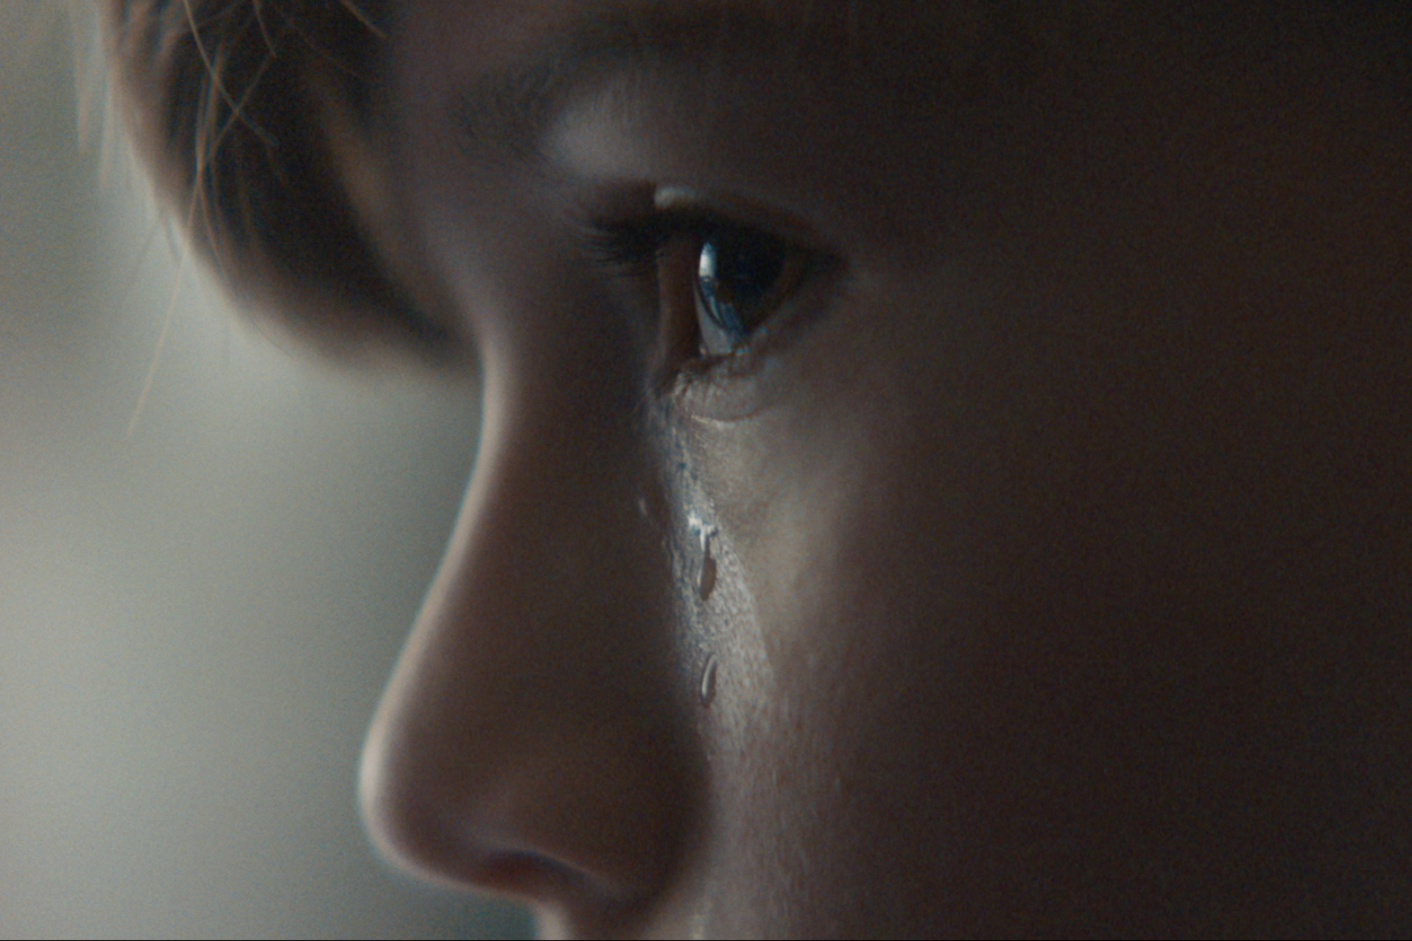
‘Boys Don’t Cry’ https://www.youtube.com/watch?v=fjo-hwAKcas
Client: White Ribbon, a Canadian advocacy group aimed at eradicating gender-based violence and promoting gender equity.
Production Company: Untitled Films.
Director: Oscar-nominated director Hubert Davis directed the PSA pro bono
Context: other ads being made about gender stereotypes, namely Gillette’s ‘The Best A Man Can Be’.

Slide 81
Film language
Cultural | Denotation/Connotation | Technical | Denotation/Connotation
Facial Expression |  | Camera work
Colour |  | Diegetic sound effects
Setting |  | Logo
Dialogue |  | Tagline
Behaviour

Slide 82
Why was this ad made?
In a recent study, half of boys said they’d heard men in their family make sexual jokes or comments about women; those boys were more likely to feel pressure to be tough and play along with sexism.
An even bigger share, 82 per cent, said they had heard someone criticize a boy for “acting like a girl.”
These stereotypical gender norms, when internalized and if unchecked, may lead to risky behaviours, including violence, bullying, dominance and control among boys, young men and men to prove they are “real men”.

Slide 83
http://www.campaignbrief.co.nz/2014/06/new-zealand-transport-agency-b.html

Slide 84
Criticism for PSAs
Public service announcements are not without their critics. Some people have noted that PSAs primarily frame issues in terms of individual behavior, like "what you can do" about crime, pollution or drug use.
PSAs rarely point out the importance of actions that groups of people could take, or the importance of policies and laws in helping solve social problems like crime, pollution or drug use.

Slide 85
Case Study: True motives?
Ten years into the KAB-Ad Council partnership, in 1971, an Italian actor playing the part of a Native American (who became known as "The Crying Indian") or “Iron Eyes Cody” appeared in an anti-litter commercial. As he looks over a polluted landscape and sheds a tear, a voice-over says: "People start pollution. People can stop it." This powerful commercial won many awards, including being named one of the top 100 advertising campaigns of the 20th century by Advertising Age. Its success inspired other environmental messages from other groups as well.

Slide 86

However, this campaign proved to be quite controversial. Shortly after its debut, various journalists wrote articles pointing out aspects that might not be immediately apparent to viewers. They noted that the tagline "People start pollution; people can stop it" focuses the responsibility for environmental pollution solely on individuals.
John McDonough, writing in Advertising Age, pointed out that the Ad Council's advisory panel for the campaign included some of the country's biggest alleged polluters—Allied Chemicals, Bethlehem Steel, American Can, and US Steel—and that the original campaign was funded by American Can. McDonough wrote, "The company may have loved the pre-Columbian landscape as much as the next guy—and delighted in having Iron Eyes letting people know it. But it consistently opposed state legislation designed to curb litter through container refund-deposit. They felt that the KAB-Ad Council campaign was actually a public relations effort on the part of the container industry to cover its opposition to refund and deposit programs.⁹
This campaign and the controversy surrounding it suggest that public service campaigns, like the commercial advertising campaigns on which they are modeled, are often meant to serve the vested interests of their sponsors.
http://www.psaresearch.com/bib9830.html

Slide 87
The Greenpeace Movement
One organization that has certainly been controversial, but not because they promote vested interests is Greenpeace, the international environmental protection organization.
Since their founding, they have combined aggressive and sometimes hostile actions against polluters with highly imaginative ways to engage the public.
Their PSAs, mostly produced in-house, have great production values and appeal to a visually oriented, hip culture, which is their primary audience

Slide 88
http://www.slideshare.net/mrsbauerart/public-service-announcements-14737006

Slide 89
The Role of the Media
Why does the Media exist?
What is its role/function in society?
Meeting Needs | Achieve particular purposes | Influence Attitudes and Behaviours
Entertainment (Blazed) | Profit | Intentionally (Blazed)
Education | Promotion (Blazed) | Unintentionally
Information (Blazed) | Public Service (Blazed)

Slide 90
Exam preparation
Have clear knowledge about four different advertisements:
Blazed (2013, NZTA)
Gorilla (2007, Cadbury)
Call to Arms (Lynx
Smoking Kid (2011, Thai Health)
Be able to apply that knowledge to different aspects of Role of Media…

